Slide 1
ISO 55000 –
The asset management bible?
Hjalmar Boon
Quality Manager/ Asset Management Advisor
Asset Management & Public Works
Province of North-Holland
Stadswerk, 8 September 2016
Notes:
1

Slide 2
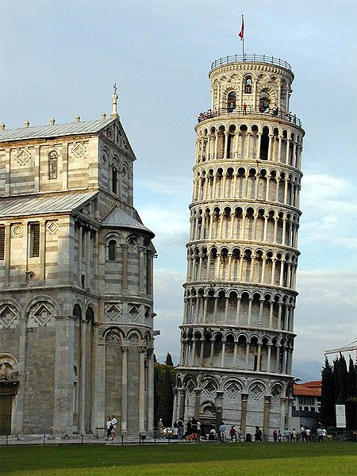
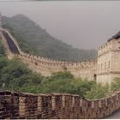
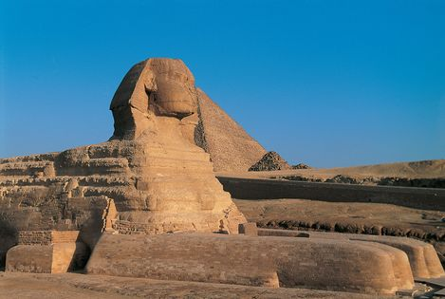
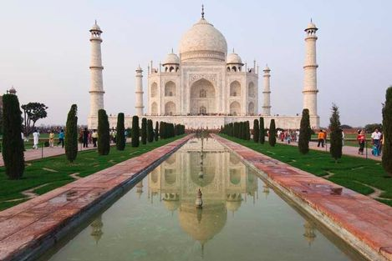
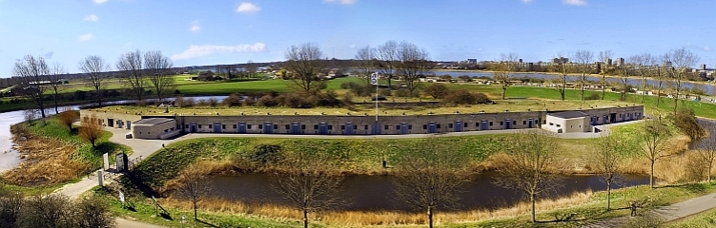
Assetmanagement

Slide 3
My background
Past
Implementer of quality management (Sony Professional Europe)
Consultant in asset management and quality management (Capgemini)
Implementer and practitioner of asset management (TenneT TSO)
Current:
Implementer of quality management and asset management (PNH)
Expert member of ISO TC 251 Asset management
Member of Dutch ISO 55001 Board of Experts
Co founder and board member of AssetManagement the Netherlands

Slide 4
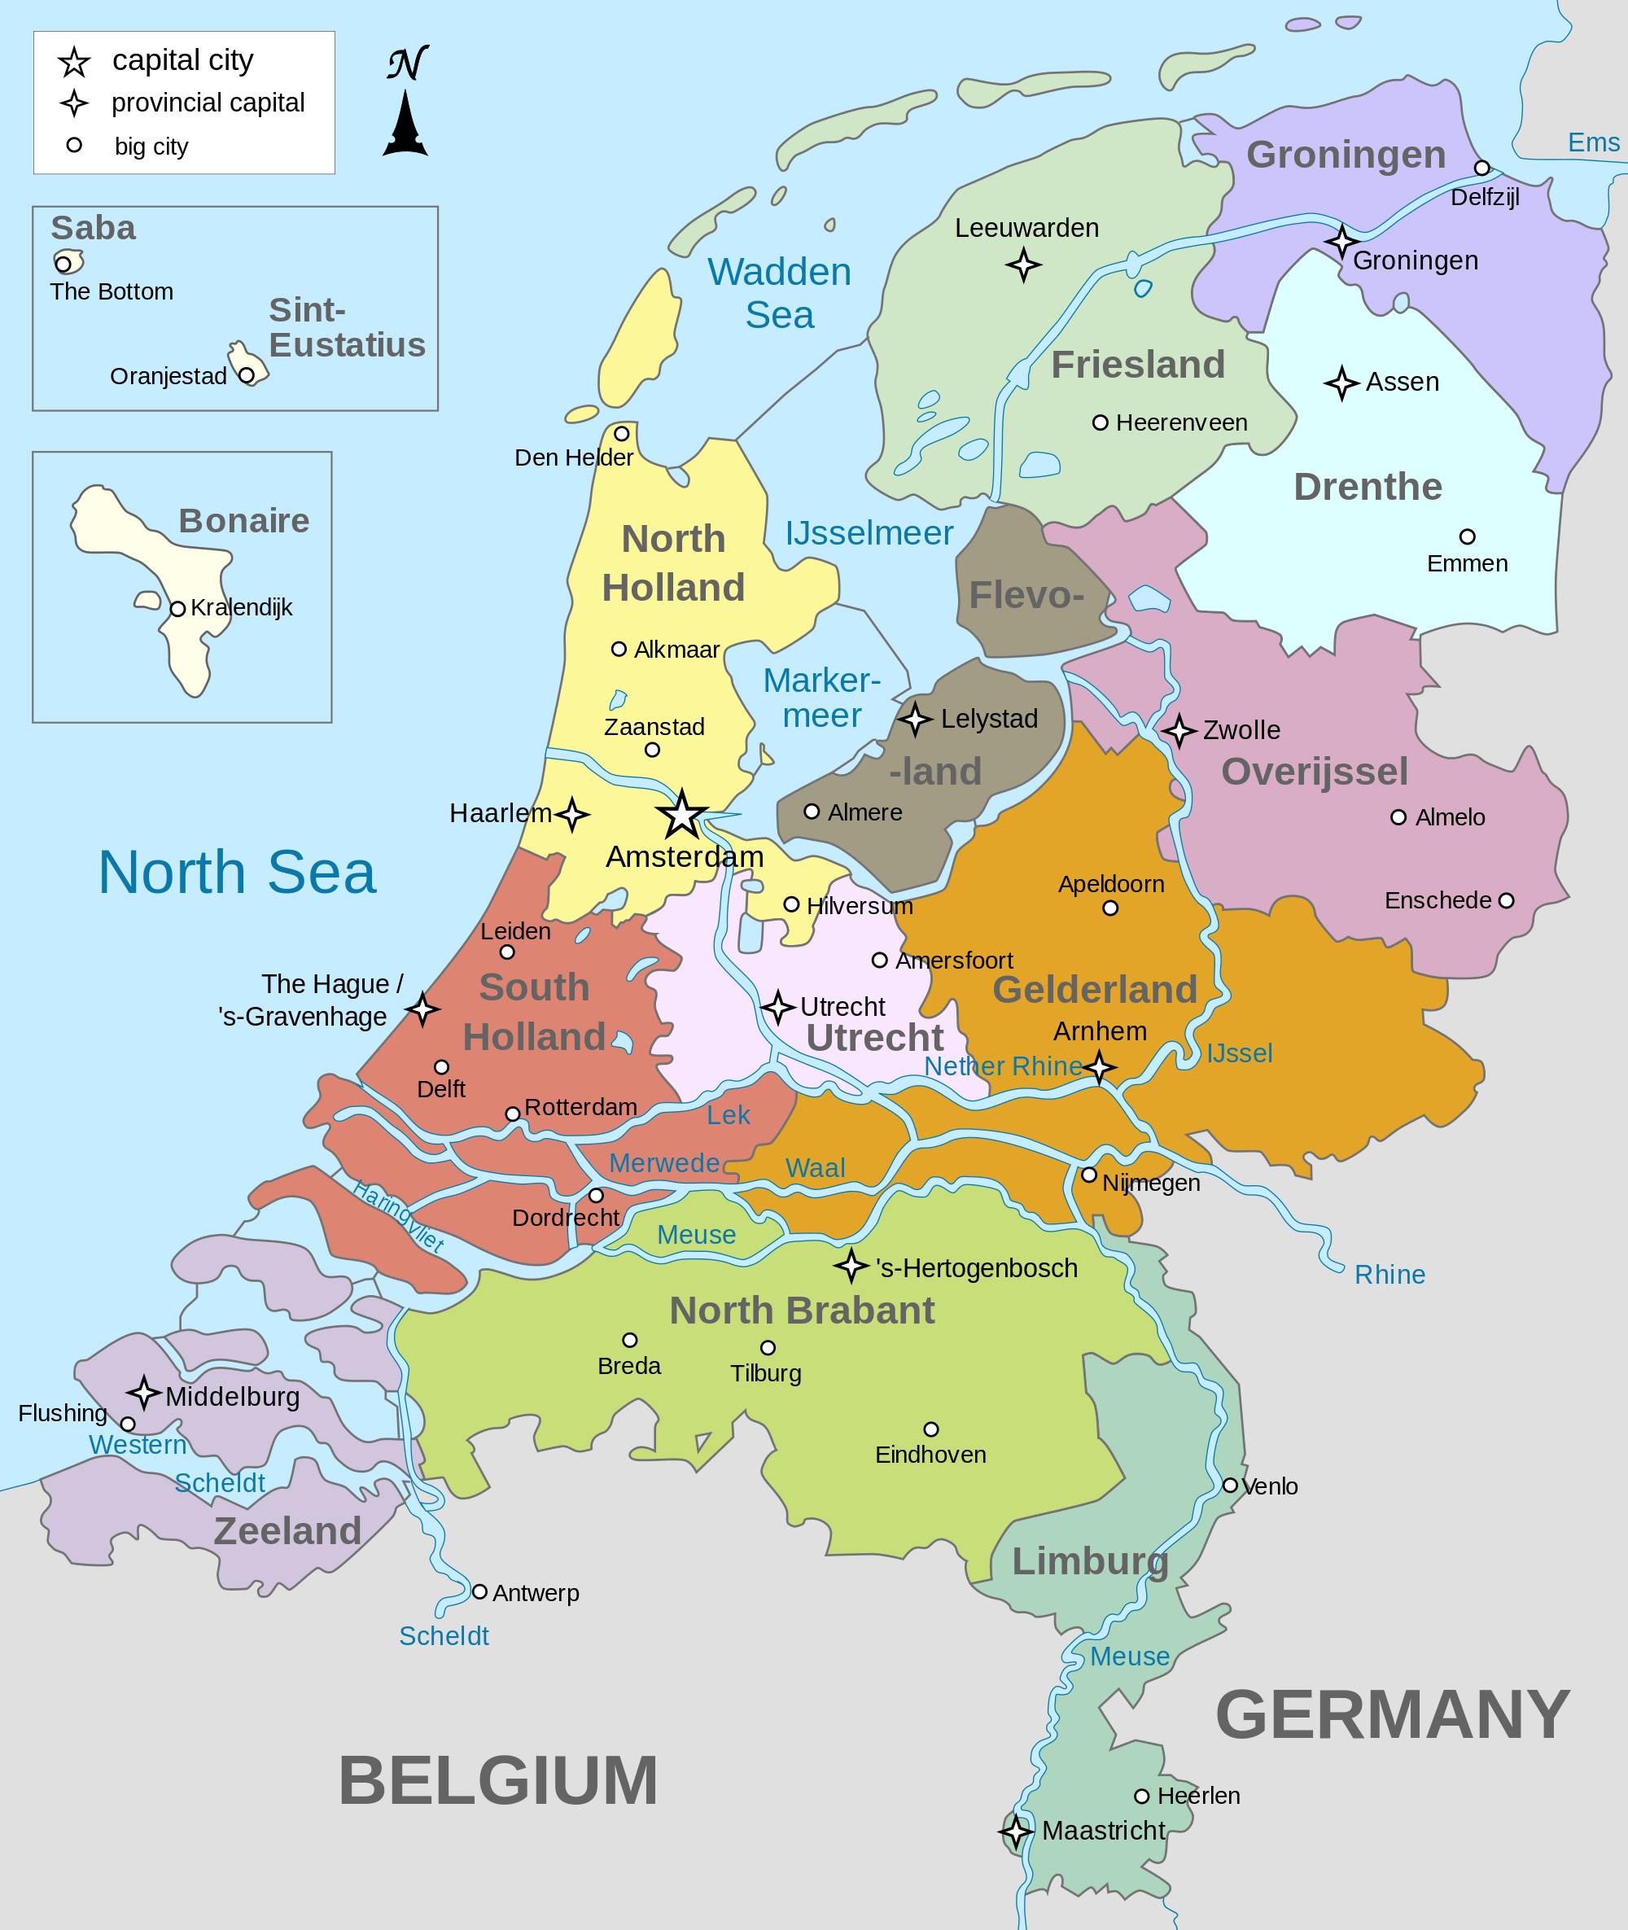
North-Holland is…
… more than Amsterdam (actually, its capital is Haarlem)
… not half of the Netherlands (but it is half of Holland)
… not Deutsch (but Dutch)
Notes:
The Province of North-Holland is also a regional government body and a roads and waterways authority responsible for a.o. building, maintaining and managing the provincial roads and waterways and for traffic management. Our mission: Safely and speedily through North-Holland.

Slide 5
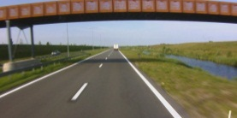

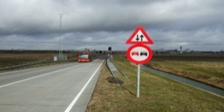
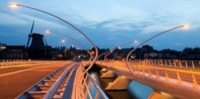
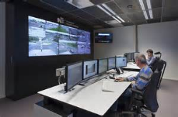
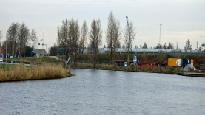
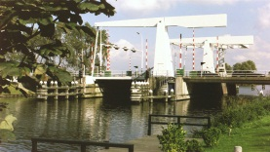
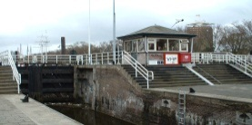
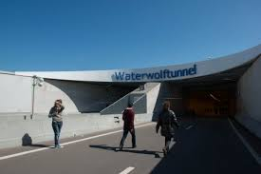
Province of North-Holland’s assets at a glance
625 km roads
390 km bicycle paths
35 km dedicated bus lanes
432 static constructions
1 traffic control centre
250 km waterways
54 dynamic constructions
10 sluices
2 tunnels
Notes:
Our assets. Replacement value approx. 2,5 billion euro. Yearly maintenance expenses (OPEX) approx. 80 million euro

Slide 6
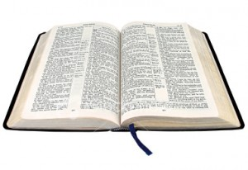
What is a bible anyway?
The one and only truth?
A recipe for everything?
Conceived by divine inspiration?
A guide?
A source of inspiration?
An important book most people haven’t read or don’t understand?

Slide 7
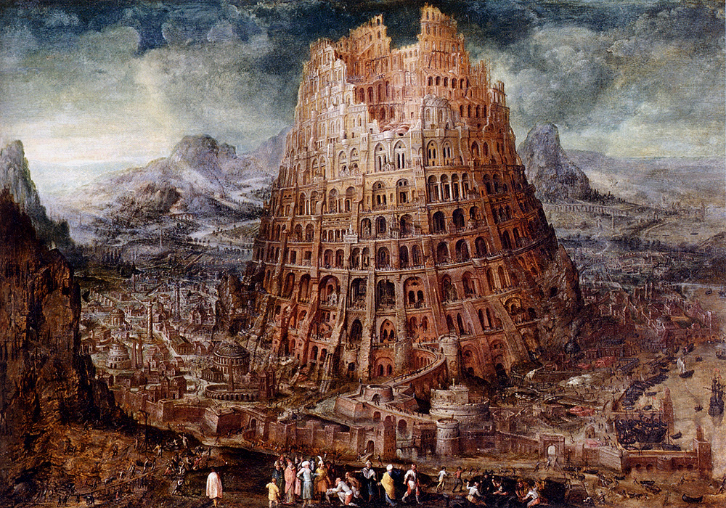
Project: Writing a bible
  Started March 2011
  International, consensus based
  Inspired by PAS 55 (UK) and IIMM (Australia) (and many other sources)
  Approximately 25 participating members, a.o.:
  UK, Australia, Canada, USA, Netherlands, Japan, South-Africa, Sweden, Germany, France, India
  Netherlands: convenor and secretary for ISO 55001/55002 and two experts (55000 resp. 55001/55002)
  Dutch mirror committee: 20+ members, a.o. Enexis, Alliander, Gasunie, Kema, DHV, Urenco, province of North-Holland
  Publication: January 2014

Slide 8
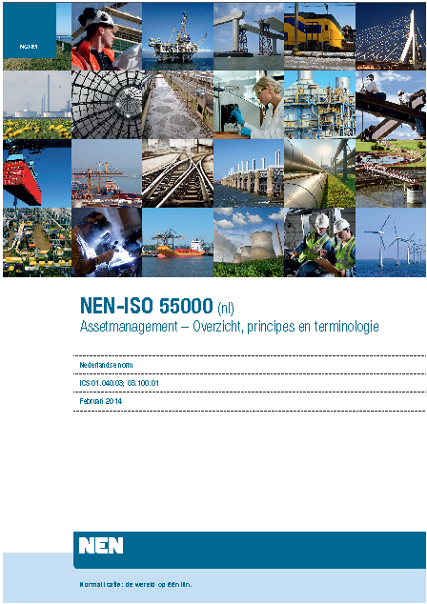
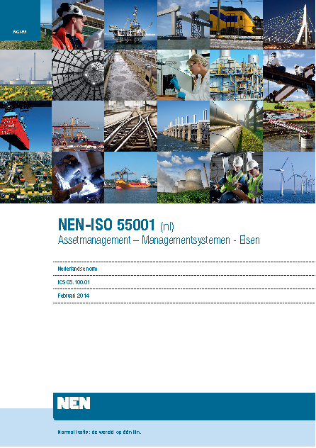
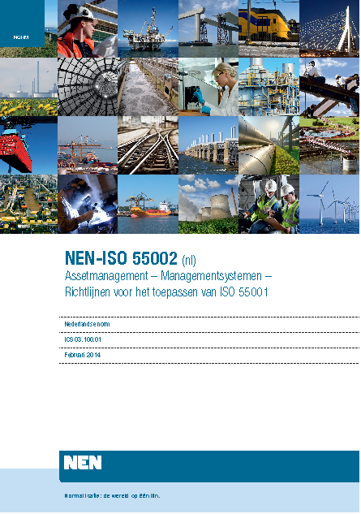
The ISO 55000 series
:

Slide 9
ISO 55000:
Why do asset management?
a) Improved financial performance
b) Informed asset investment decisions
c) Managed risk
d) Improved services and outputs
e) Demonstrated social responsibility
f) Demonstrated compliance
g) Improved reputation
h) Improved organizational sustainability
i) Improved efficiency and effectivity

Slide 10
Fundamentals
Value
The purpose of assets is to create value for the organization and its stakeholders
Alignment
Asset management translates the organizational objectives into technical and financial decisions, plans and activities
Leadership
Leadership and work culture are determinants of realization of value
Assurance
Asset management gives assurance to the organization and its stakeholders that assets will fulfill their required purpose

Slide 11
Definitions of asset management and asset management system
Coordinated activity of an organization to realize value from assets
Set of interrelated or interacting elements of an organization to establish policies and objectives and processes to achieve those objectives.
  ISO 55000 Asset management - overview, principles and terminology
Managing
the organization
Asset management
Asset
management system
Asset
portfolio

Slide 12
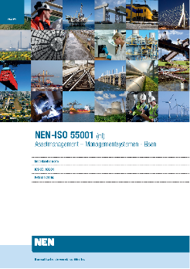
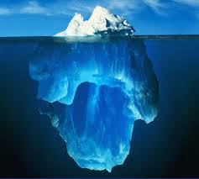
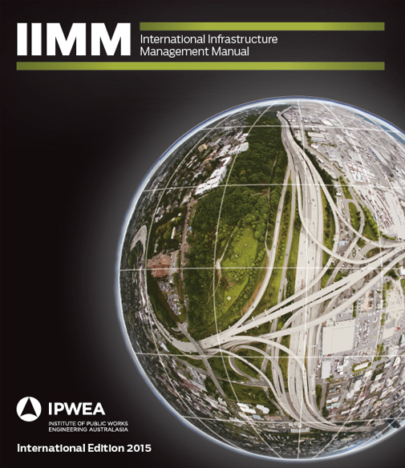
Asset management and ISO 55001
ISO 55001 (What)
  Requirements for an asset management system
Asset management (How)
  Philosophy, approach, set of principles, body of knowledge, methods, models,
  techniques, tools...
  International Infrastructure
  Management Manual (IIMM)
WHAT
HOW

Slide 13
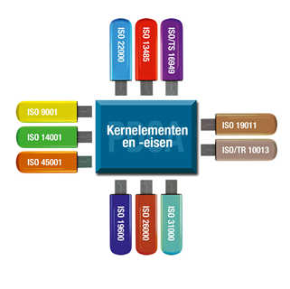
Generic structure and core requirements for all ISO management system standards
Organizational context
Leadership
Planning
Support
Operation
Performance evaluation
Improvement

Slide 14
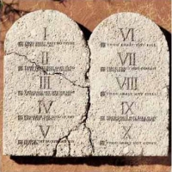
The 10 commandments of ISO 55001
1. Make a stakeholder analysis
Translate stakeholder requirements into plans activities
Make sure to have adequate asset management information
Know and manage your risks
Lead the organization

Slide 15
The 10 commandments of ISO 55001
Establish a clear organization
Ensure the employees have the appropriate skills and knowledge to perform their tasks
Outsource wisely
Control the operational processes
Be a learning organization
    .

Slide 16
So what is ISO 55001?
Not a description or prescription of how to do asset management or establish an asset management system!
(look to the International Infrastructure Management Manual (IIMM) for that)
The requirements for a modern risk based asset management system
Less prescriptive and more management oriented than PAS 55
Not sector specific, applicable in all asset managing sectors
Notes:
So, like the Bible, it requires interpretation!

Slide 17
  How Province of North-Holland has implemented asset management and achieved certification
Managing
the organization
Asset management
Asset
management system
Asset
portfolio
Notes:
OK, we are ready to start. 6.1. About the asset management system.

Slide 18
Why ISO 55001 compliant asset management?
And why certification?
Grip on quality
Cost control
Transparancy
Proactive
From execution to direction
Big stick
Objective confirmation

Slide 19
Prelude (1): Professionalising roads and waterways management (2008 – 2012)
Roads and waterways management is more than maintenance!
Execution conforming to plan
From discipline to integral maintenance to integral execution of infrastructure actvities
Improve asset data management
Separate planning from execution
Not yet asset management!
Managing
the organization
Asset management
Asset
management system
Asset
portfolio
Notes:
A little look back: We were already professionalising our roads management for a couple of years. We realised that it was more than maintenance.
…
But then we realised it was not yet asset management

Slide 20
Prelude (2): Quality management and asset management (2008 – 2012)
Describing existing processes
Internal auditing and improving
User (“customer”) satisfaction
A management system
Gap analysis ISO 9001 and PAS 55
Managing
the organization
Asset management
Asset
management system
Asset
portfolio
Notes:
At the same time, we were implementing quality management.
…
And then we realised that quality management for us was actually the same as asset management.
For an organization that manages assets as its primary process, quality management and asset management are essentially the same thing. ISO 9001 is stronger on the horizontal axis/operational level, ISO 55001 on the vertical axis/strategic and tactical level

Slide 21
Gap analysis (2012)
Scope
Roles and responsibilities
Line of sight
Asset risk management system
Documentation of the management systeem
Asset data management
Competence management
?
?

Slide 22

Completing asset management
Critical
assets
Define
Policy &
strategy
Evaluate &
improve
Establish
Manage & programme
Performance
connections
measure-
ment
Asset management
system
infrastructure
Roles
Inspect &
analyse
clear
Plan &
prepare
Build &
maintain
Auditing/
monitoring
Notes:
But we were still missing some pieces.

Slide 23
Asset management implementation
1. Awareness
2. Preconditions
3. Designing the organisation
4. Learning by doing
5. Roll out
6. Continual improvement
Need assessment
Stakeholder analysis
Internal / external quick scan
Review process documents
Implementation plan
AsM mission and vsion
Risk policy statement & decision model (AM)
Business model (roles AO, AM, SP)
Asset management policy statement
Process architecture: Asset Management processes, documentation and templates
Responsibilities
Service level agreement AO/AM
Competence model
Co-operation agreement AM/SP
Basic training / train the trainer)
Learning environment (draft process outputs)
AsM procedures, working instructions, tools,
PI-targets for process performance
Definitiee process outputs
Formal AsM organization
Complete risk register
Implementation of IT-xupport
Training employees
Internal audit, improvement
Certification
Asset management development
Time
Notes:
This is the implementation plan we established. Currrently we are in phase 6. Some important things about implementation plans for asset management:
multi-discipline. Business strategy, technical, financial, risk management, organisational and change management competences are needed. We have a core implementation team that reflects that
Leadership/management involvement and drive
Iterative. You can and probably need to work in iterations. We do this by inserting a “learning by doing” phase
Provides focus
Think about the story: Why are we doing this? Create energy. We chose a positive message and emphasised the relationship with earlier development programmes: This is the logical next step. Our communication underlines this with simple cartoon-like illustrations. AM is about people.
Message: 80% of what we do remains unchanged, but the new 20% is important to reach a new level of professional ability and be prepared for the future

Slide 24
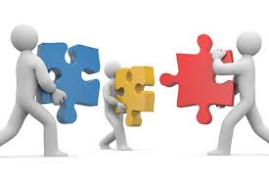
Making it work
Steering committee
Multi discipline implementation team, themes:
    Strategic asset management plan
    Process and performance management
    Management systeem
    Risk management
    Life cycle management
    Data and information management
Management team members theme sponsors
Training, communication and implementation support
Program executed by own personnel supported by consultants

Slide 25
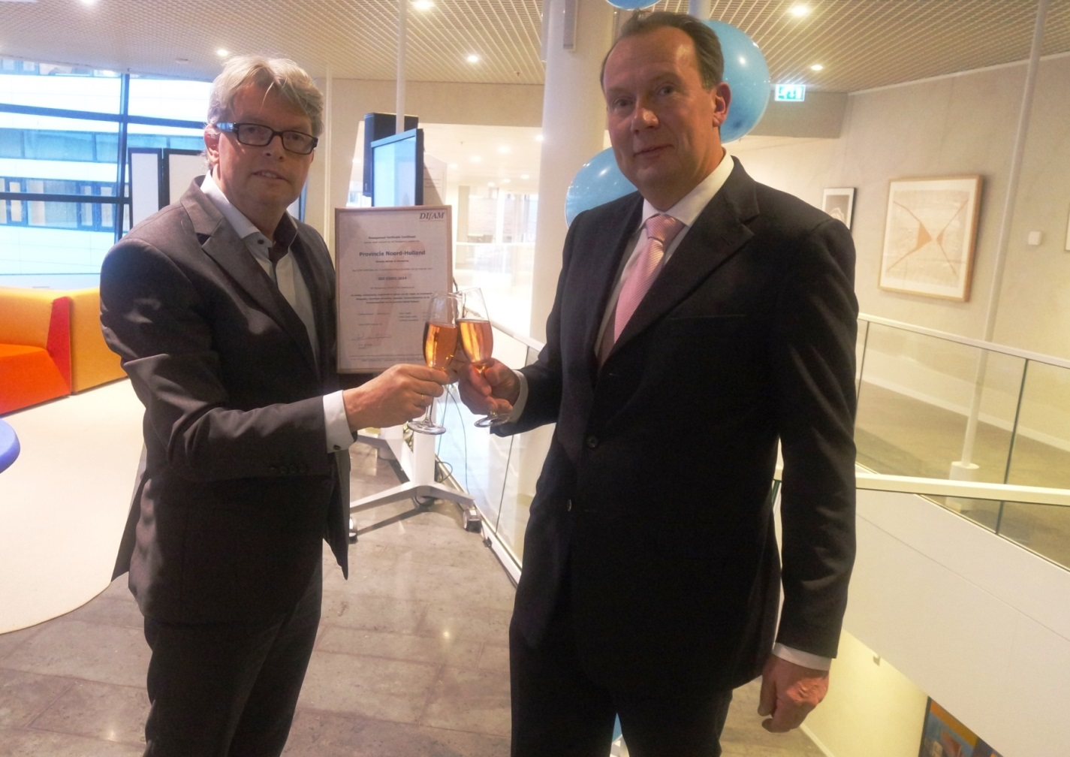
The result: ISO 55001 certificate
November 26 2015
Notes:
Scope: Ontwerp, bouw, reconstructie, onderhoud en beheer van de assets met een maatschappelijk nut (de wegen en kunstwerken, fietspaden, vaarwegen en sluizen, openbaar vervoernetwerken en de Verkeerscentrale/verkeersmanagementareaal) van de provincie Noord-Holland

Slide 26
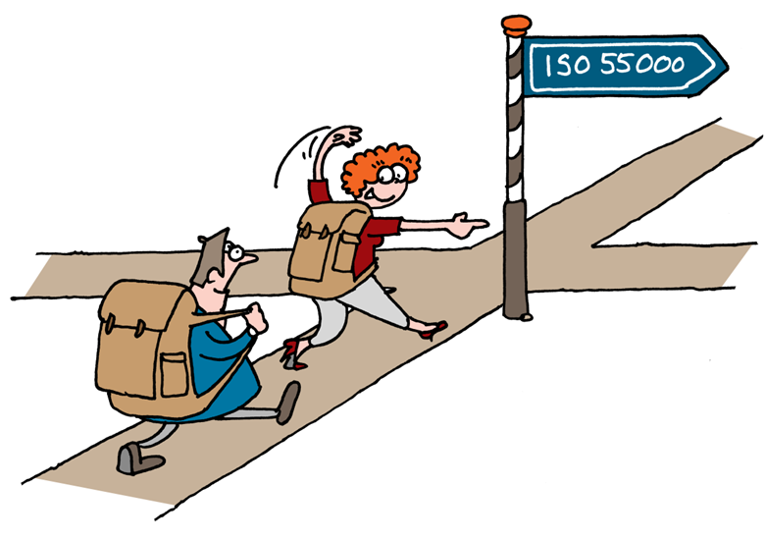
Closing remarks
ISO 55001 and external audits provide focus and urgency
Many interrelated developments necessitate flexible implementation planning
Learn to accept iterative working and “dynamic” AMS products
After initial certification, the journey continues!
Notes:
So now we are at the eve of certification. What have we learned, what have we done right, what could be better?

Slide 27

Thank you for your attention!
boonh@noord-holland.nl
+31 6 51197560

