Slide 1
Evolution from Maintenance to Asset Management in Municipalities
Amsterdam, Sept.8th 2016
Jan-Lucas Hof

Slide 2
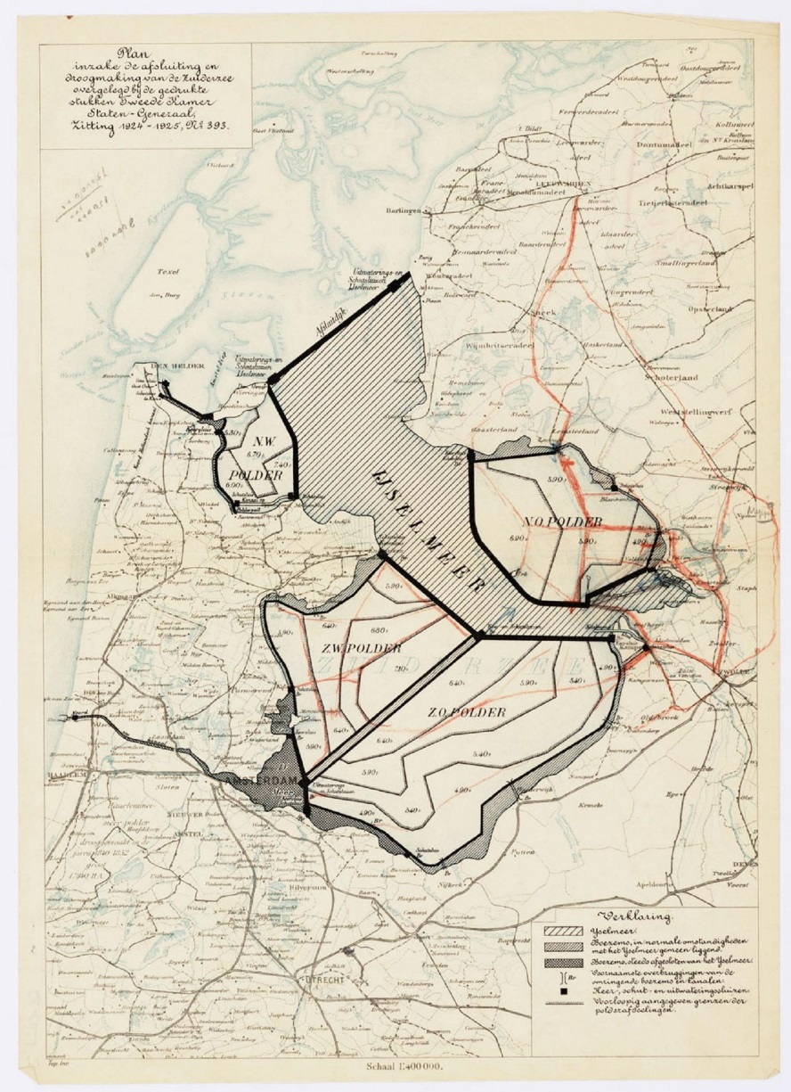
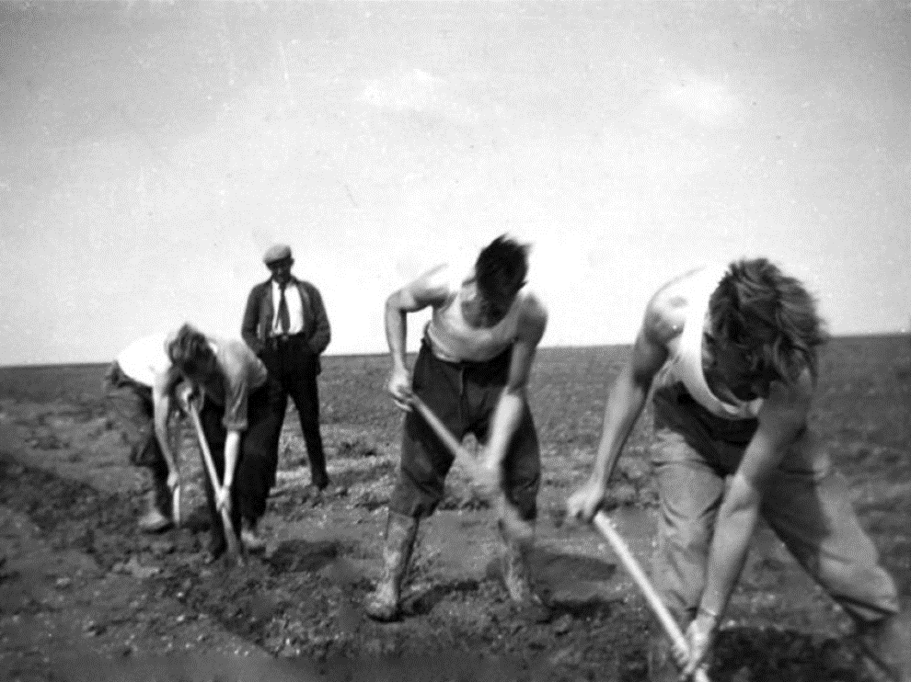
About myself
Notes:
Hello, my name is Jan-Lucas Hof. As a child at Elementary School I had a dream.
My grandfather was polderpioneer in the NorthEast-polder – the first large polder of the plan ‘Lely’ in the Netherlands.
I grew up in the Flevopolder – the second large polder of plan ‘Lely’.
And my dream was to be involved in the development of the third large polder, ‘The Markerwaard’.
But in 1986 the Government decided for a no-proclamation of the Markerwaard
….
My dream went down the drain…
…
Fortunately I was able to work for Antea Group, and for more than 17 years I was involved in many terrific and challenging projects.

Slide 3
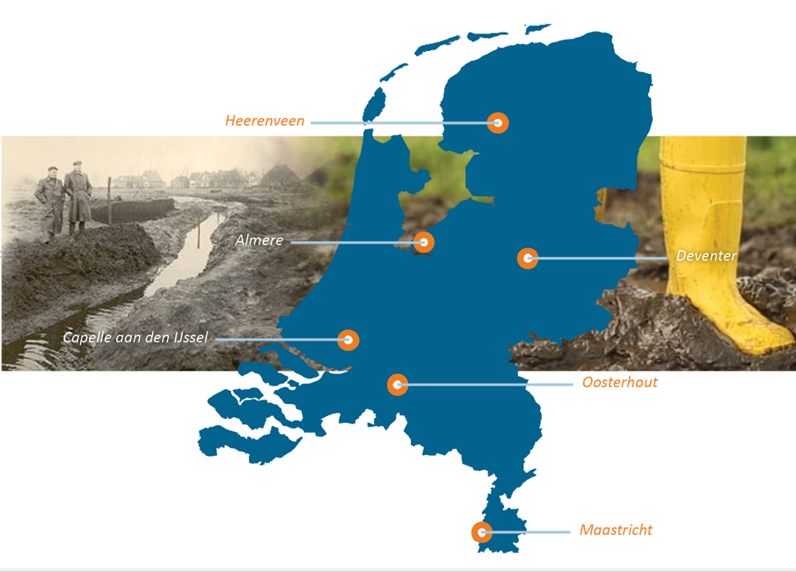
About Antea Group Netherlands
Notes:
For more than sixty years, Antea Group has been an international engineering and environmental consulting firm specialized in full-service solutions in the fields of environment, infrastructure, urban planning and water. Our approach is down to earth.
At Antea Group Netherlands we work with 1.700 collegues in six different business units.
I currently work at the business unit Maintenance and Data as Projectmanager and senior advisor Asset Management. Together with about 150 collegues the unit gives advice to about half of the 400 municipalities in the Netherlands concerning maintenance of their public spaces in an efficient and smart way.

Slide 4
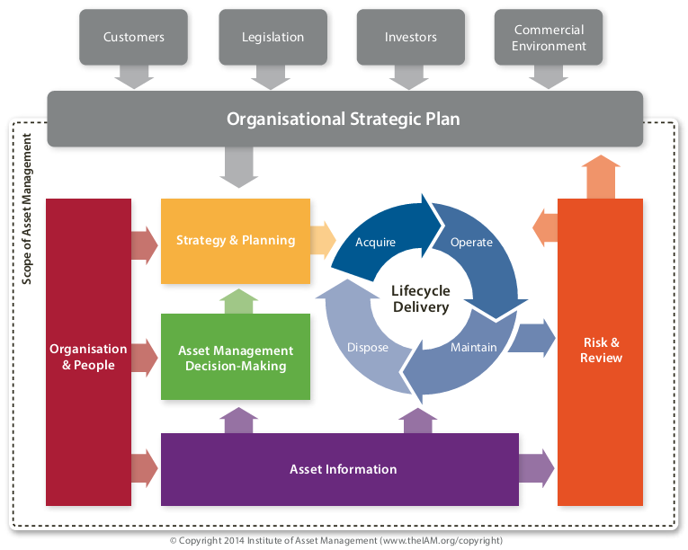
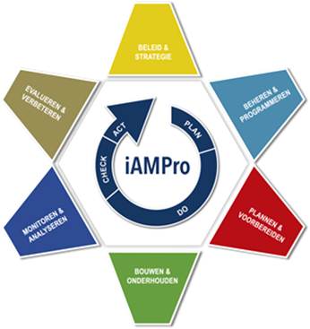
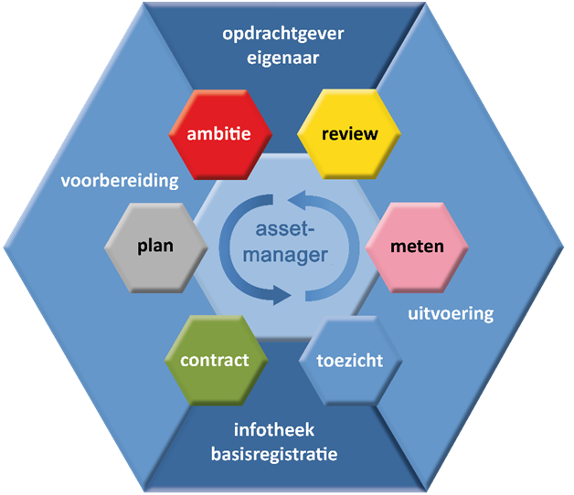
Asset Management
Notes:
As Antea Group Netherlands we think Asset management is a method that concerns all of our business units, and helps our customers to get the most out of their assets.
The pass 55 method and the ISO 55000 certificate is our ‘foolproof’ compass and a large group of people within our business units is trained in these methods.
But today I don’t want to tell you all about these methods as pass 55 and ISO 55000, although I would love to.
Because we have special visitors from Australia, I thought it would be a good idea to tell you about the development of management and maintenance by municipalities in the Netherlands during the last 50 to 70 years.
You could call it an evolution theory in maintenance by municipalities towards Asset Management.
I would like to show you the distinct phases and characteristics including practical examples of innovations, so you can see the latest developments and where we are at .

Slide 5
The evolution
CITY COUNCIL
Effect
Output
Output
Input
Input
Input
REALISATION
1973
1995
2010
time
Notes:
So here it is: our evolution theory in maintenance carried out by municipalities concerning Asset Management.
It’s an abstract scheme devided in four distinguished phases, from left to right in time.
At the top, in red, you can see the city council that is responsible for the strategic goals of the city.
At the bottom, in green, the realisation of maintenance of public spaces.
I will explain the four phases of this evolution from past to present.

Slide 6
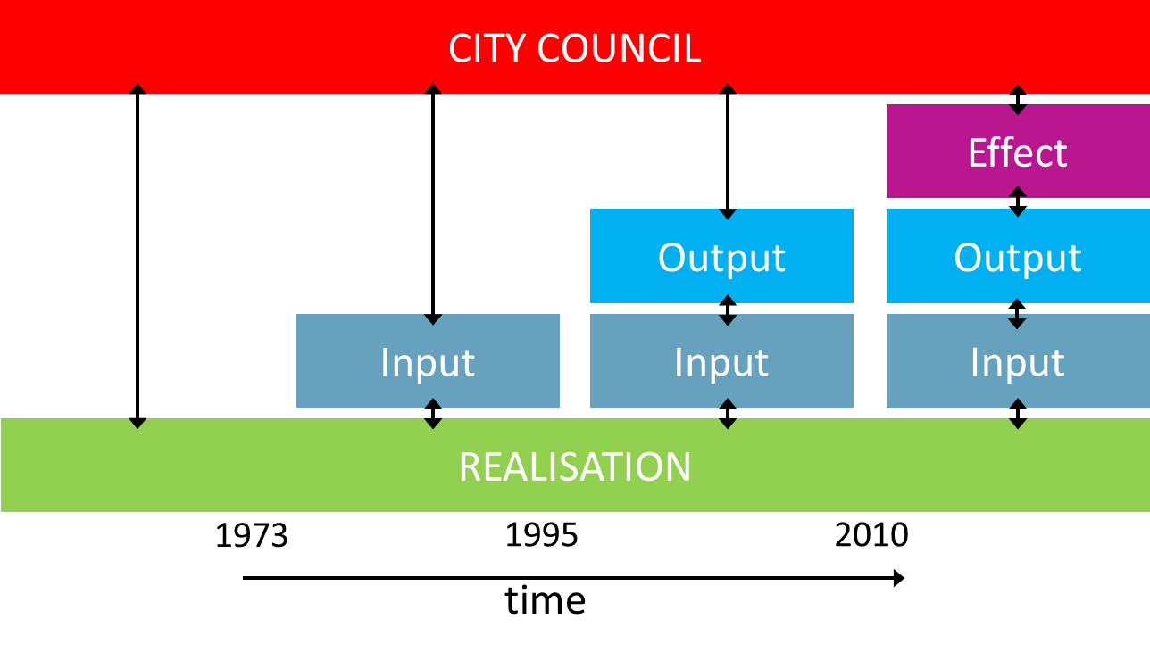
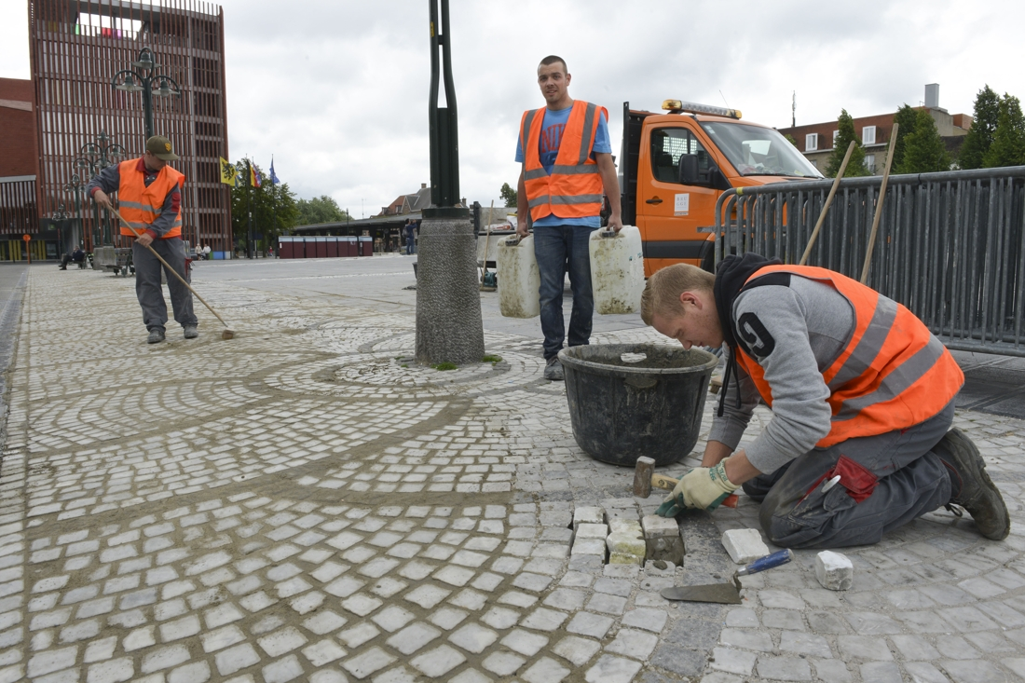
The evolution – 1st phase: autonomous realisation
Great distance between Council and Realisation
Small public organizations
Relatively small public space
Realisation decides what, when and how
No computers, realisation knows it all
1
Notes:
This fase is characterized by a big gap between councils and realisation.

Slide 7

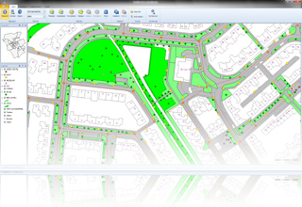
The evolution – 2nd fase: after the oil-crisis
Because of the financial crises, management demands transparency and substantiation of budgets from Realisation
Public space is growing rapidly
Substantiation by discipline (roads, sewage, public parcs/green areas,..)
Based on input, first computers help substantiate budgets (area x measure x unit price)
The first maintenance-software available
2
Notes:
This second fase is characterized by substantiation of budgets.
This is the first step in the line of sight.

Slide 8
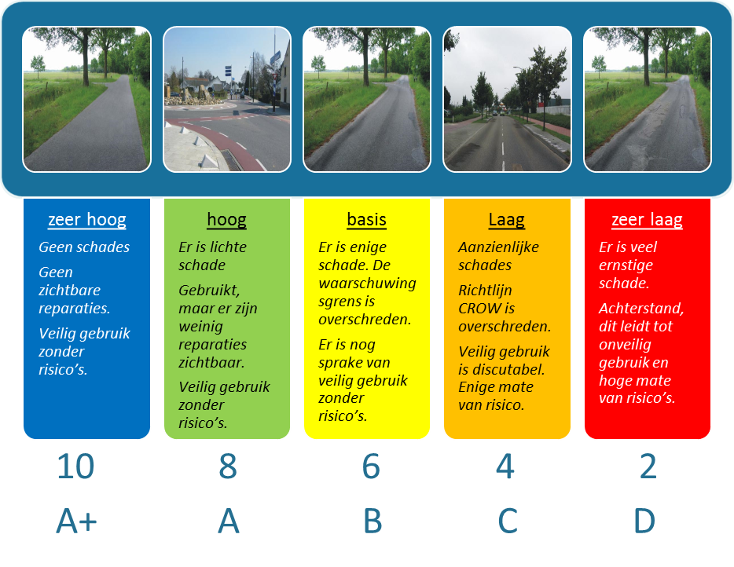

The evolution – 3rd fase: Quality
To decrease the distance between Council and Realisation we developed a new language – talking about quality (output)
Discussions with politicians: often integral for public space (all disciplines)
Transparant diversity in quality of public space as a result of discussions with local politics
3
Notes:
This phase is characterized by better communications between councils and realisation by talking about quality.

Slide 9
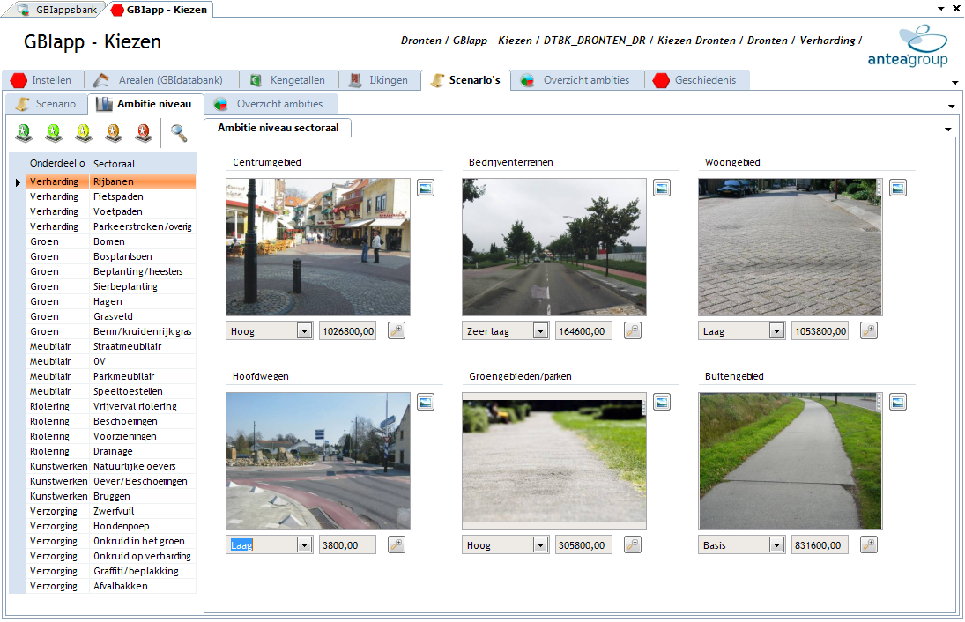

The evolution – 3rd fase: Quality
Very High
High
Base
Low
Very Low
(area x quality x unit price)
Notes:
In the 90’s, we made an app called ‘Choose’. This is an innovative app that our customers still often use. With this app, a city council is able to choose a certain level of quality (very high, high, neutral, low, very low) of their public space for the various disciplines (roads, trees, etc..). The council can also determine a real time budget that is needed for maintaining the chosen quality for the various city-parts.
The app calculates real-time area x measure price . Once the council has chosen for a certain level of quality (output), realisation knows what kind of input is needed in means of measures.
So there is a transparant link between chosen quality (output) and the measures that are needed.
This is the second step in the line of sight.

Slide 10
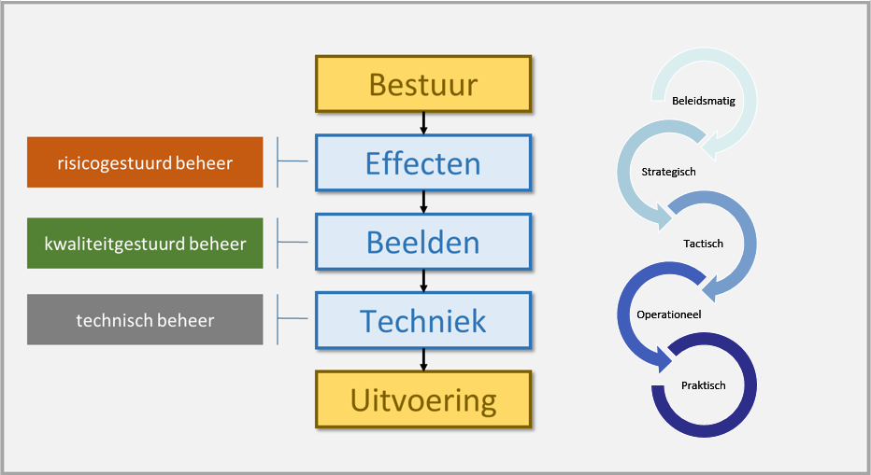
The evolution – 4^{rth} fase: Asset Management
Discussions with politicians about the ‘effects’ in the municipality; ‘making policy’
The ‘line of sight’ is complete
Additional differentiation in maintenance
Additional data needed: stakeholders / environmental / financial / time / …
4
Line
of
Sight
Notes:
This phase is characterized by closing the line of sight. The policy of Councils is translated to effects; these effects can be translated to needed quality’s and measure’s.
To do so, a lot of additional data is needed for translating effects to needed quality’s in the public space. Data about stakeholders, environment, financial

Slide 11
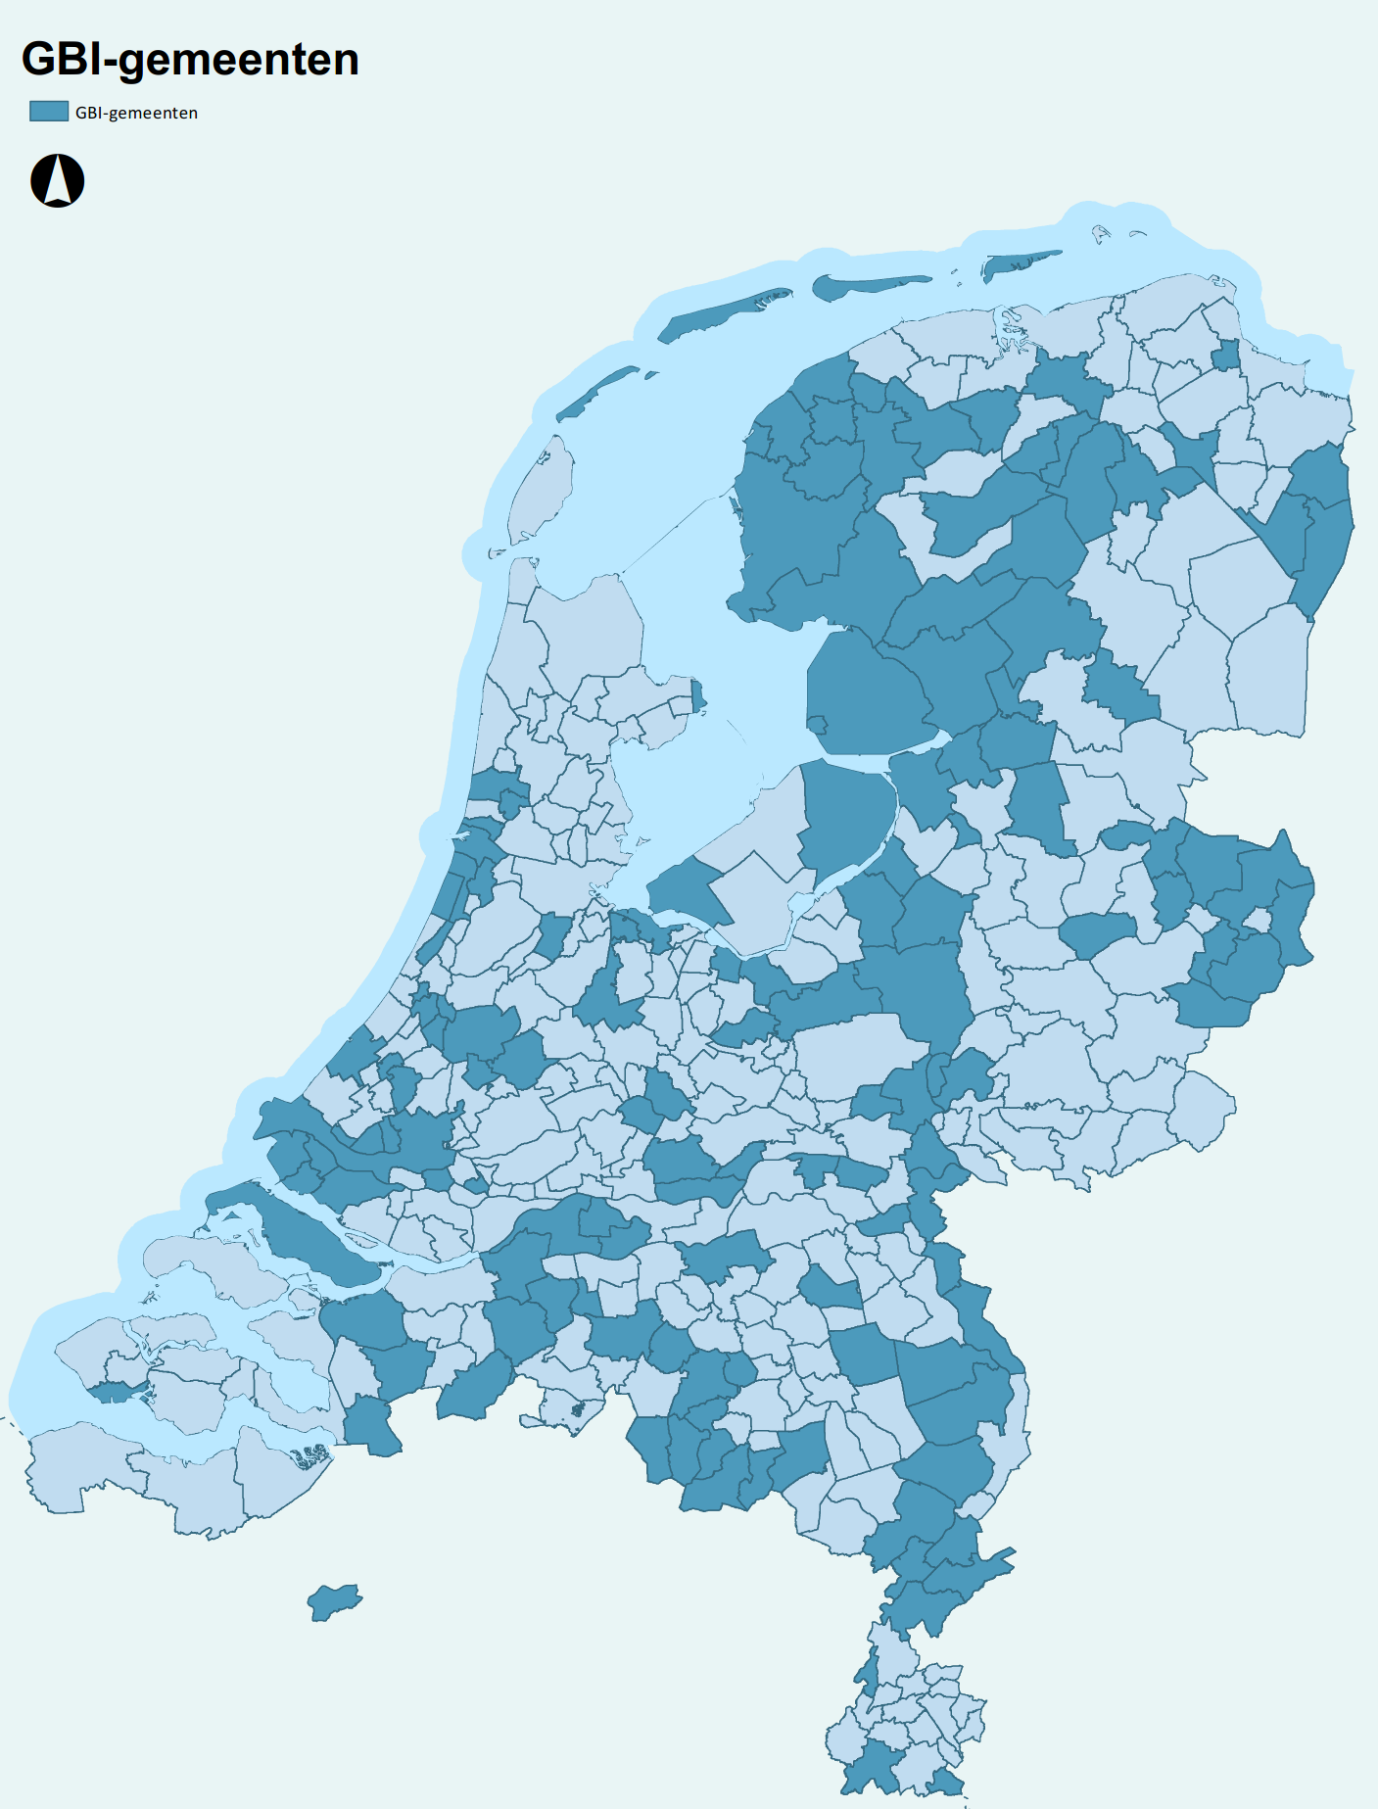
Invest in standards
BGT
IMGEO
IM(O)BOR
IMKL
GWSW
NEN2767
GWGBI
…
Notes:
As market-leader in software for maintaining public spaces of municipalities, we think it’s very important to realise data-standards. This way, we can use different data to obtain information about the strategic goals of the city councils.
And once we can do, you can do a lot of fun stuff.

Slide 12
Benchmark: watch, compare, learn
Notes:
(optie)
For example.
Thanks to data-standards, it is easy to benchmark the municpalities on various themes in public spaces.

Slide 13
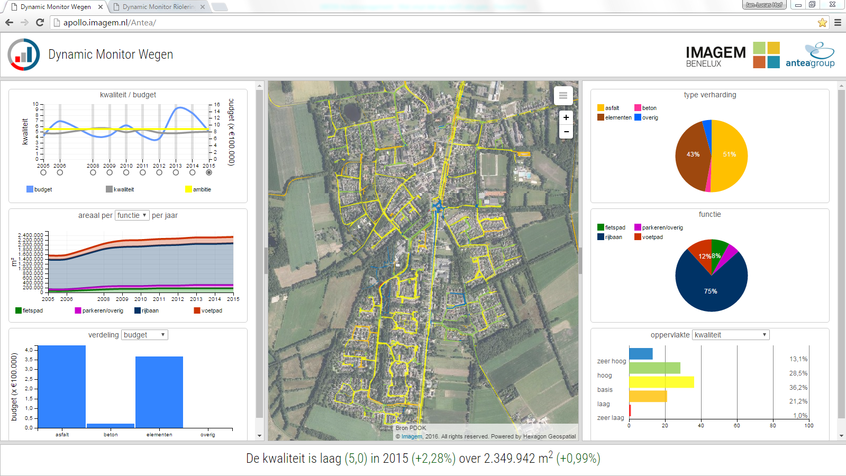
Antea Group Smart City M.apps
Notes:
And more…
One of our latest innovations is presenting data from our maintenance software, financial systems, reportings of citizens within municipalities, aswell as other data-sources in so called BI-tooling, Business Intelligence tooling.
As you can see, this BI-tooling is web-based and shows you all of the relevant information in a dashboard.
This helps us to understand our public spaces better and how to maintain them in the best way, so we can achieve the strategic goals.
I would like to show you a short film about this innovation.

Slide 14
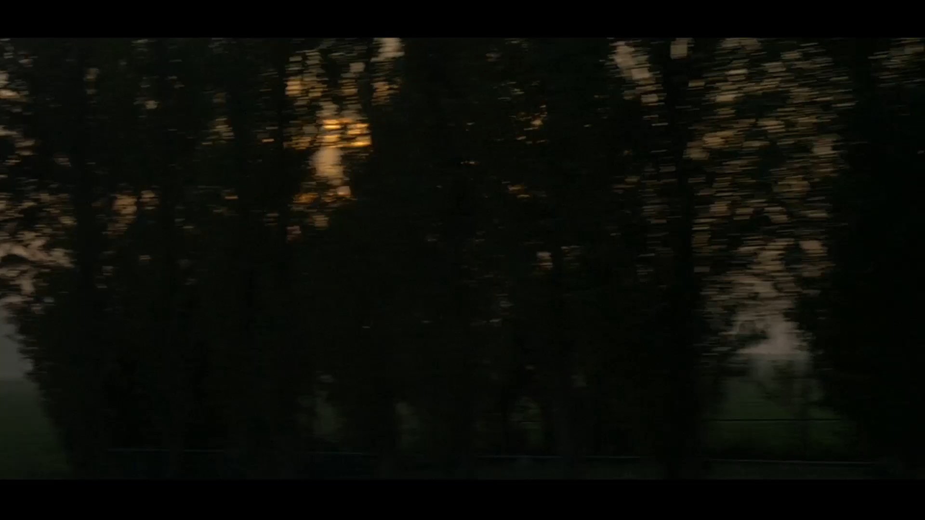
Antea Group Smart City M.apps

Slide 15
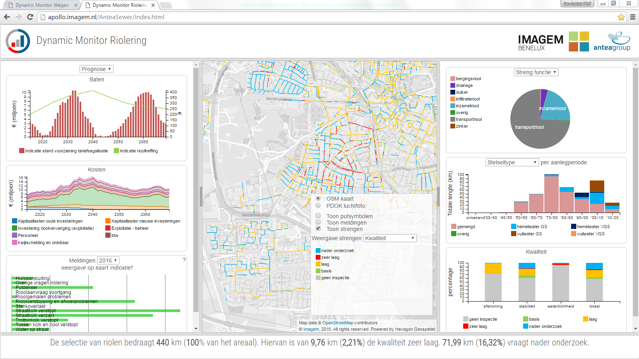
Antea Group Smart City M.apps
Notes:
(optie)
The information you get out of data is as good as the quality of the data itself. All the information should be real time and up-to-date. Standards should be unequivocal (=onmiskenbaar/ondubbelzinnig).
Therefore, it’s important that municipalities develop the right asset-information strategies.

Slide 16
Asset Management – the logical next step…
CITY COUNCIL
Effect
Output
Output
Input
Input
Input
REALISATION
1973
1995
2010
‘Closing the Line of Sight with good data’
Notes:
So, to end my presentation I would like to state that in my opinion Asset Management is the logical next step for municipalities regarding their Maintenance.
Closing the line of sight. Of course with good data.

Slide 17
Notes:
Thank you for your time. Are there any questions?

