Slide 1

Asset Management in context of broader financial reporting
Chris Champion
Director International
IPWEA
chris.champion@ipwea.org

Slide 2
Sustainability of services should be key objective of every Agency

Slide 3
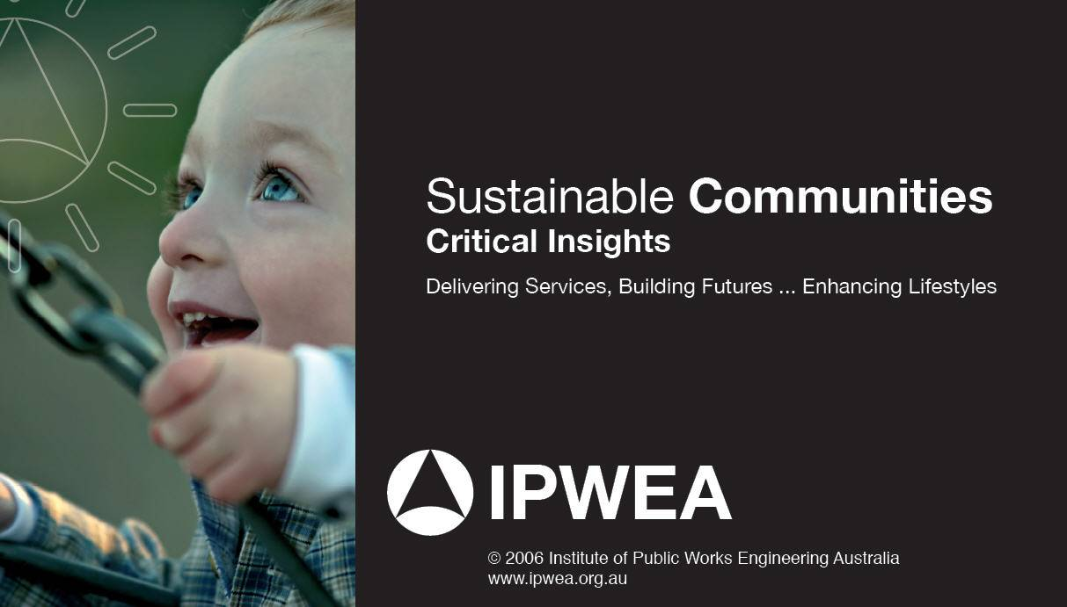

Financially Sustainable Communities
3 KEY ELEMENTS
Stewardship:
Role of Elected Members
Managing existing
as well as new:
Asset Management Planning
Essential part of Business:
Long Term Financial Planning

Slide 4
Providing elected members with full costs, options & priorities

Slide 5
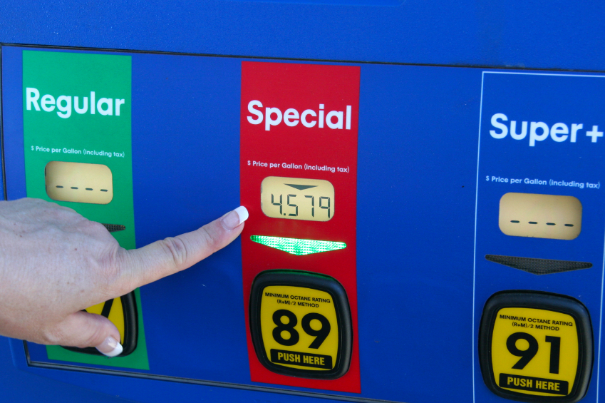
Making the link between levels of service and price

Slide 6

Moving from annual budgeting to long term financial planning
Link long term expenditure to revenue
Make responsible use of debt

Slide 7

AM is about managing our priorities, risks & funds required

Slide 8
Manage the gap
(not just funding the gap)
Understanding impact new assets
Better asset information
Timely maintenance
Improved work practices
Disposal of assets
Alternative service delivery
Lower levels of service
Innovative solutions

Slide 9




Work within a national framework
IPWEA provides the tools
Add some drivers!

Slide 10
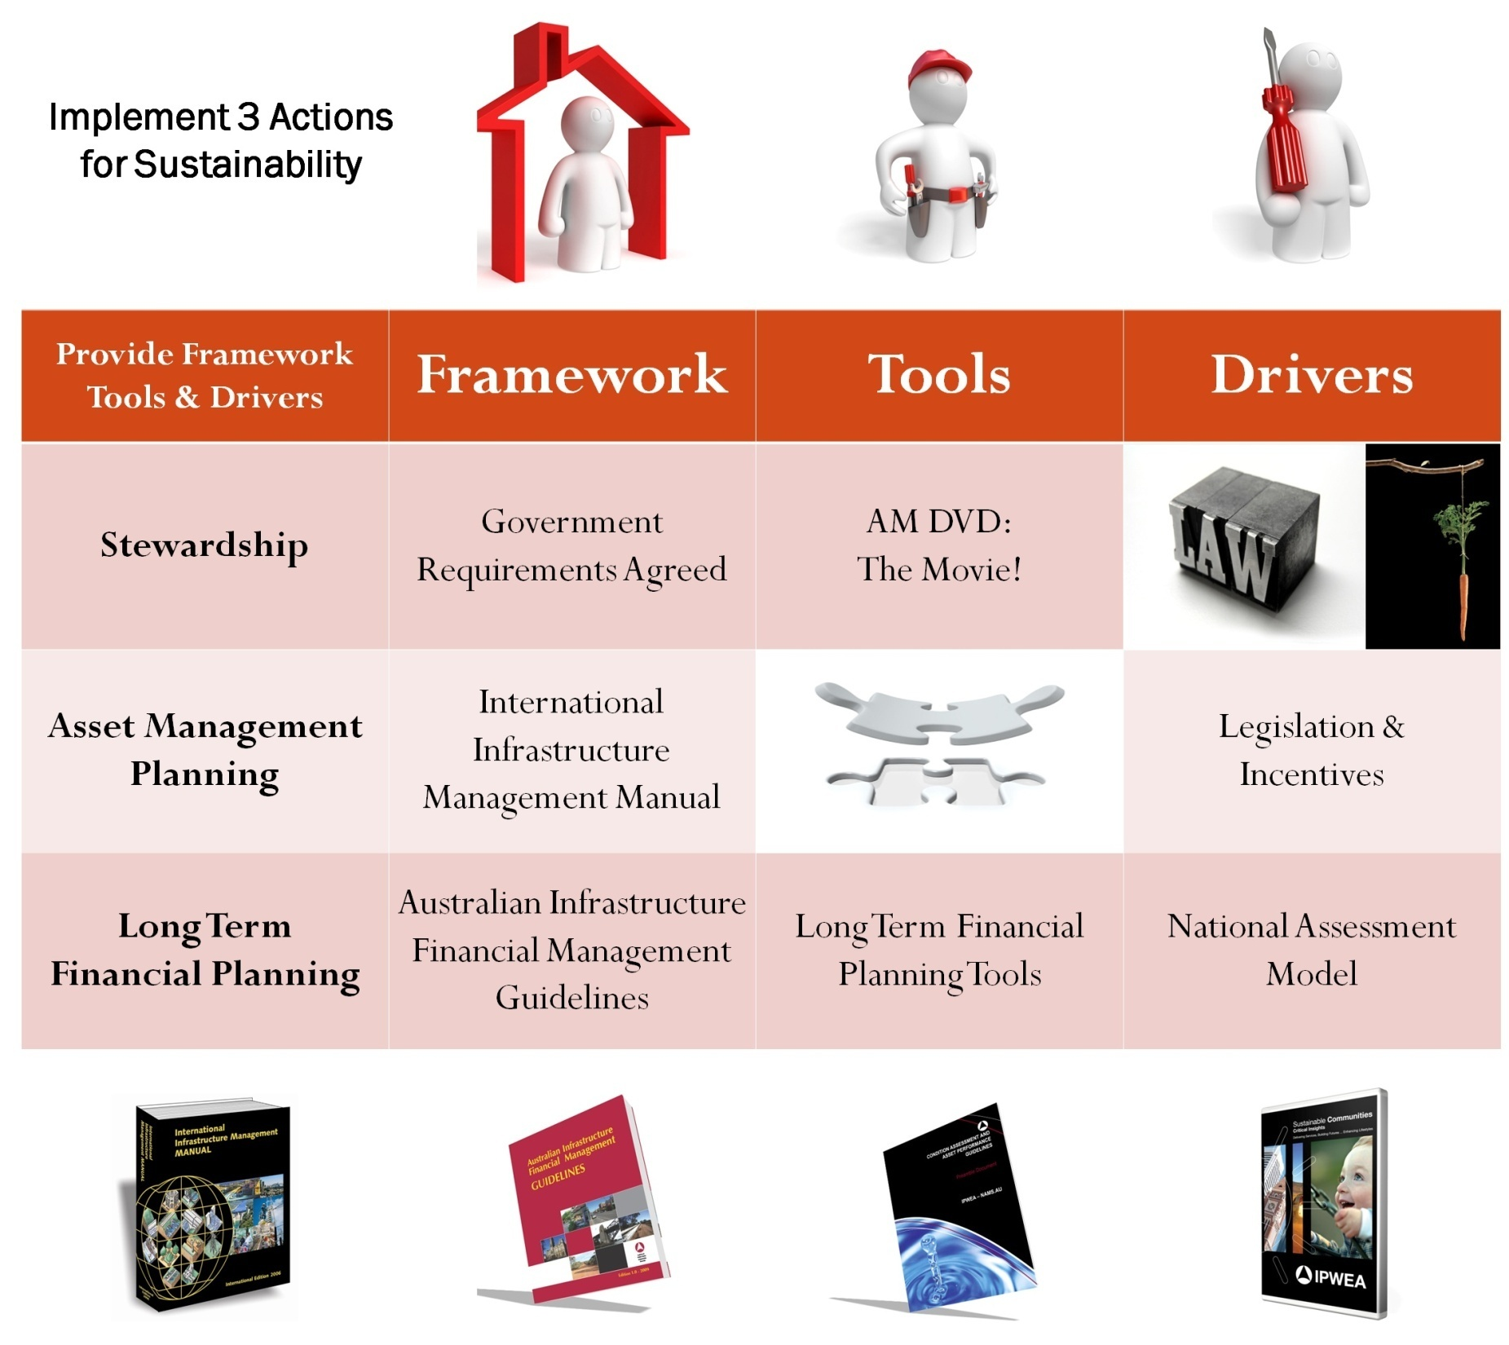
NAMS.PLUS

Slide 11

Engineers don’t understand Accountants
Accountants don’t understand Engineers

Slide 12
Concept A. Sustainable Asset Management
To provide desired level of service in most cost effective manner for present & future generations

Slide 13
Concept B. Accrual Accounting
Recognition of assets, liabilities, equity, income & expenses in Financial Statements as incurred

Slide 14

Engineers & Accountants talking the same language!

Slide 15
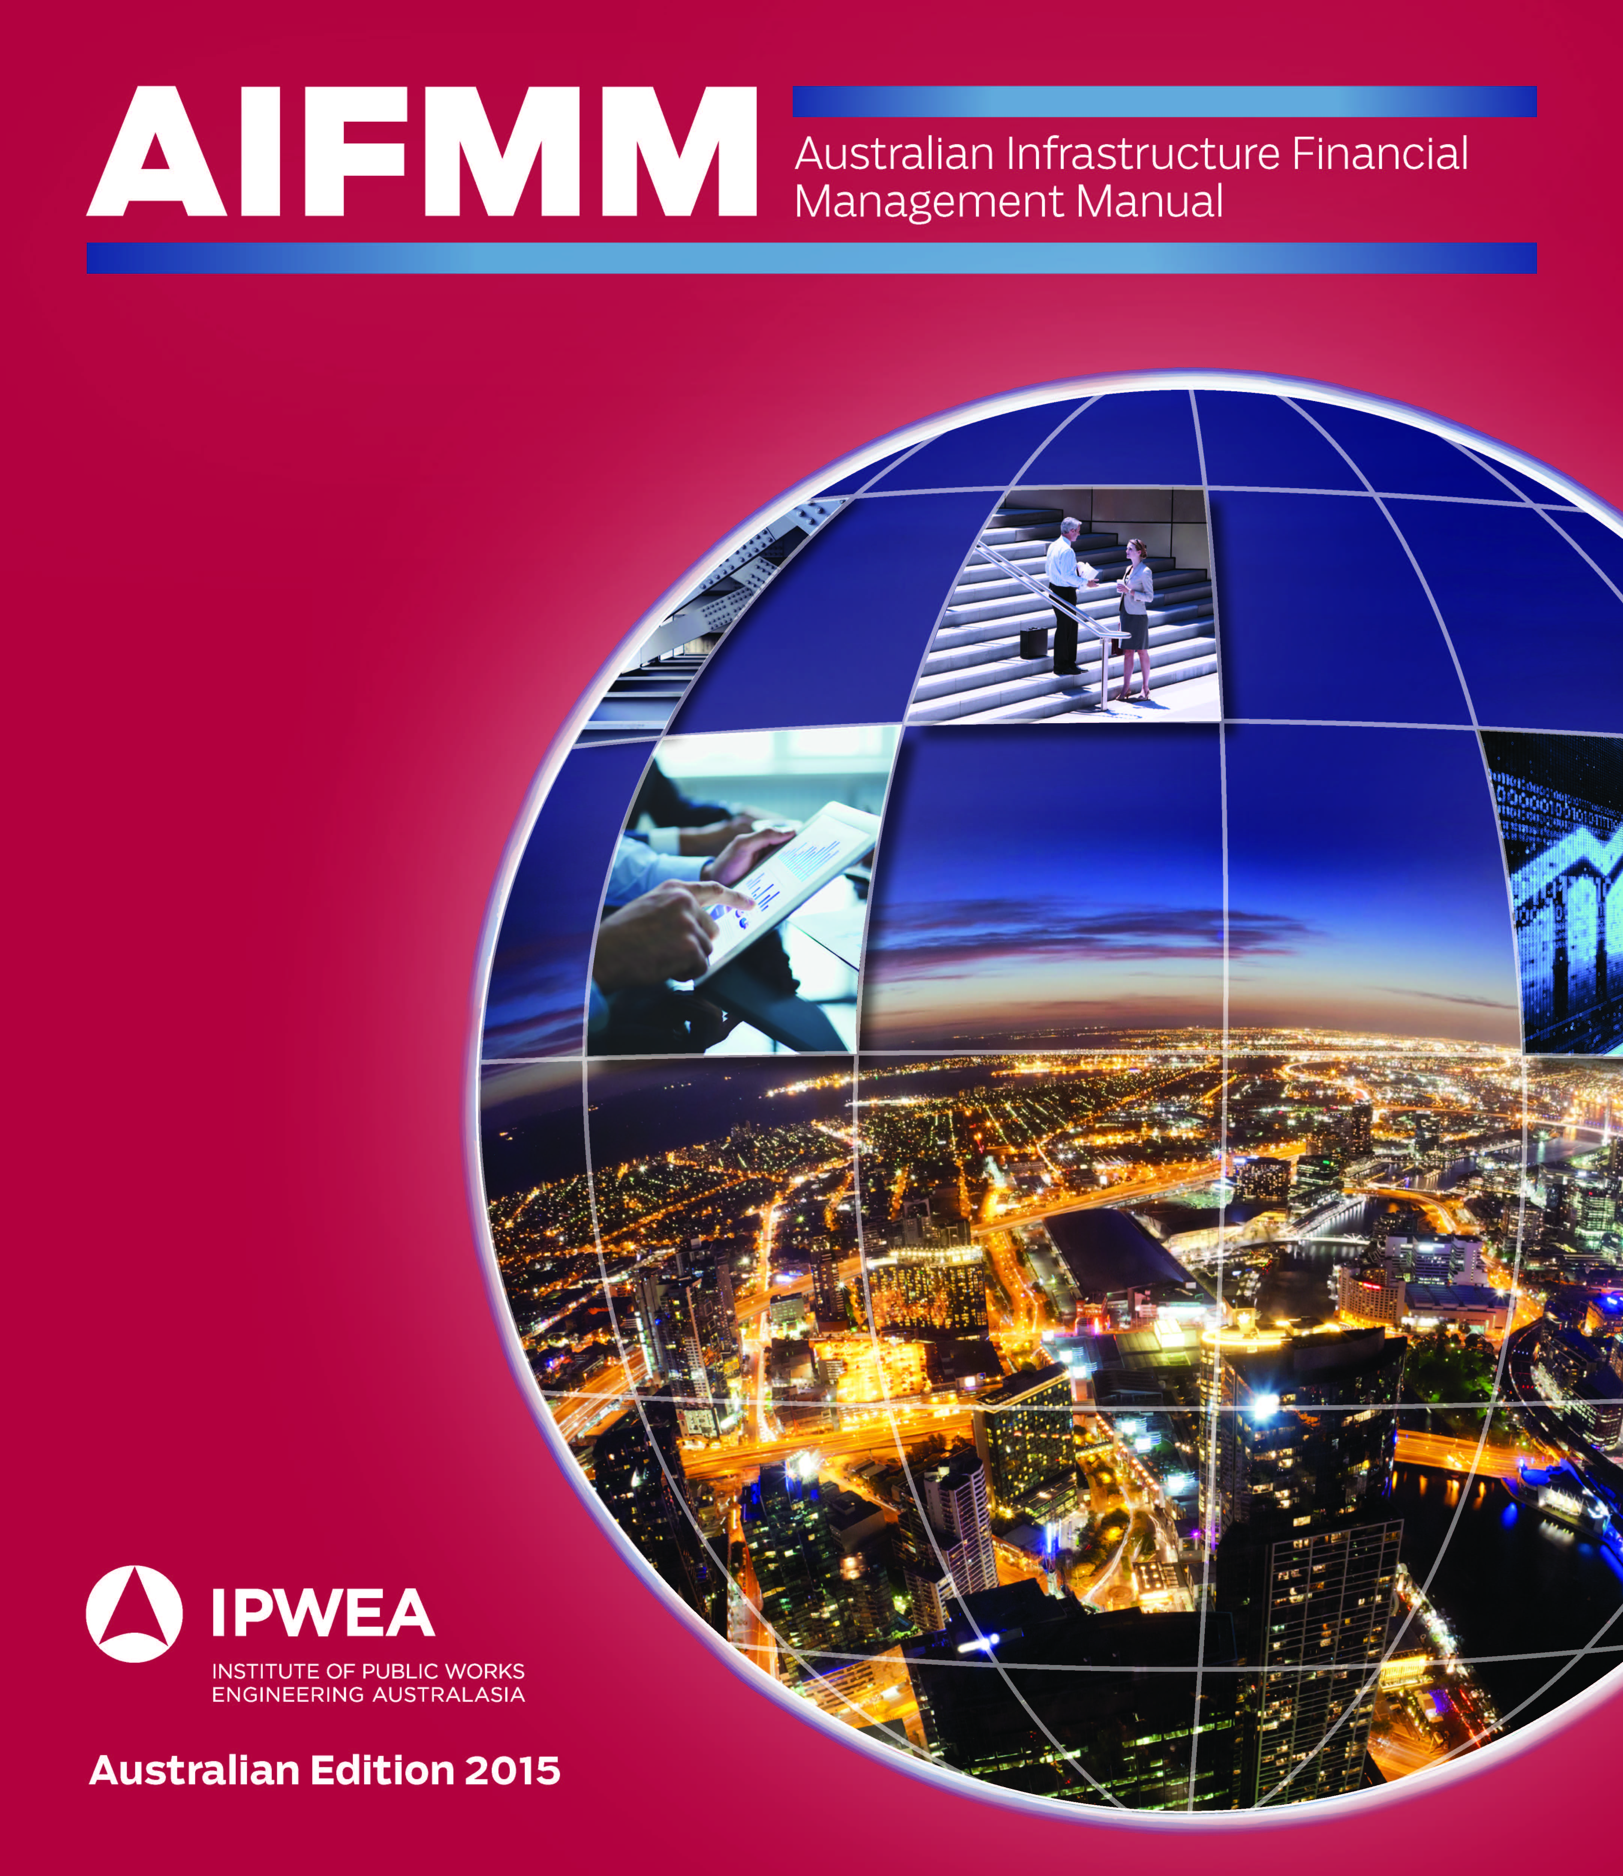
Infrastructure Financial
Management Manual

Slide 16

International Infrastructure Management
Manual
Australian Infrastructure
Financial Management
Manual
www.ipwea.org

Slide 17



ISO 55000: The What IPWEA: The How

Slide 18
Concept B. Accrual Accounting
- requires valuation of assets
- reporting of asset value in Accounts
(historic cost vs fair value)
= current replacement cost
- consumption of assets as depreciation

Slide 19
Concept B. Accrual Accounting
- requires asset registers
- defining assets at component level
- assessing replacement costs
- testing for impairment
- useful lives

Slide 20
Asset Consumption Asset Renewal
Accountants Asset Managers
Past Investments Future Investments
Annual Depreciation Expense Renewal Cashflow Projections

Slide 21


Sustainability is maintaining financial capital & infrastructure capital for long term
+

Slide 22
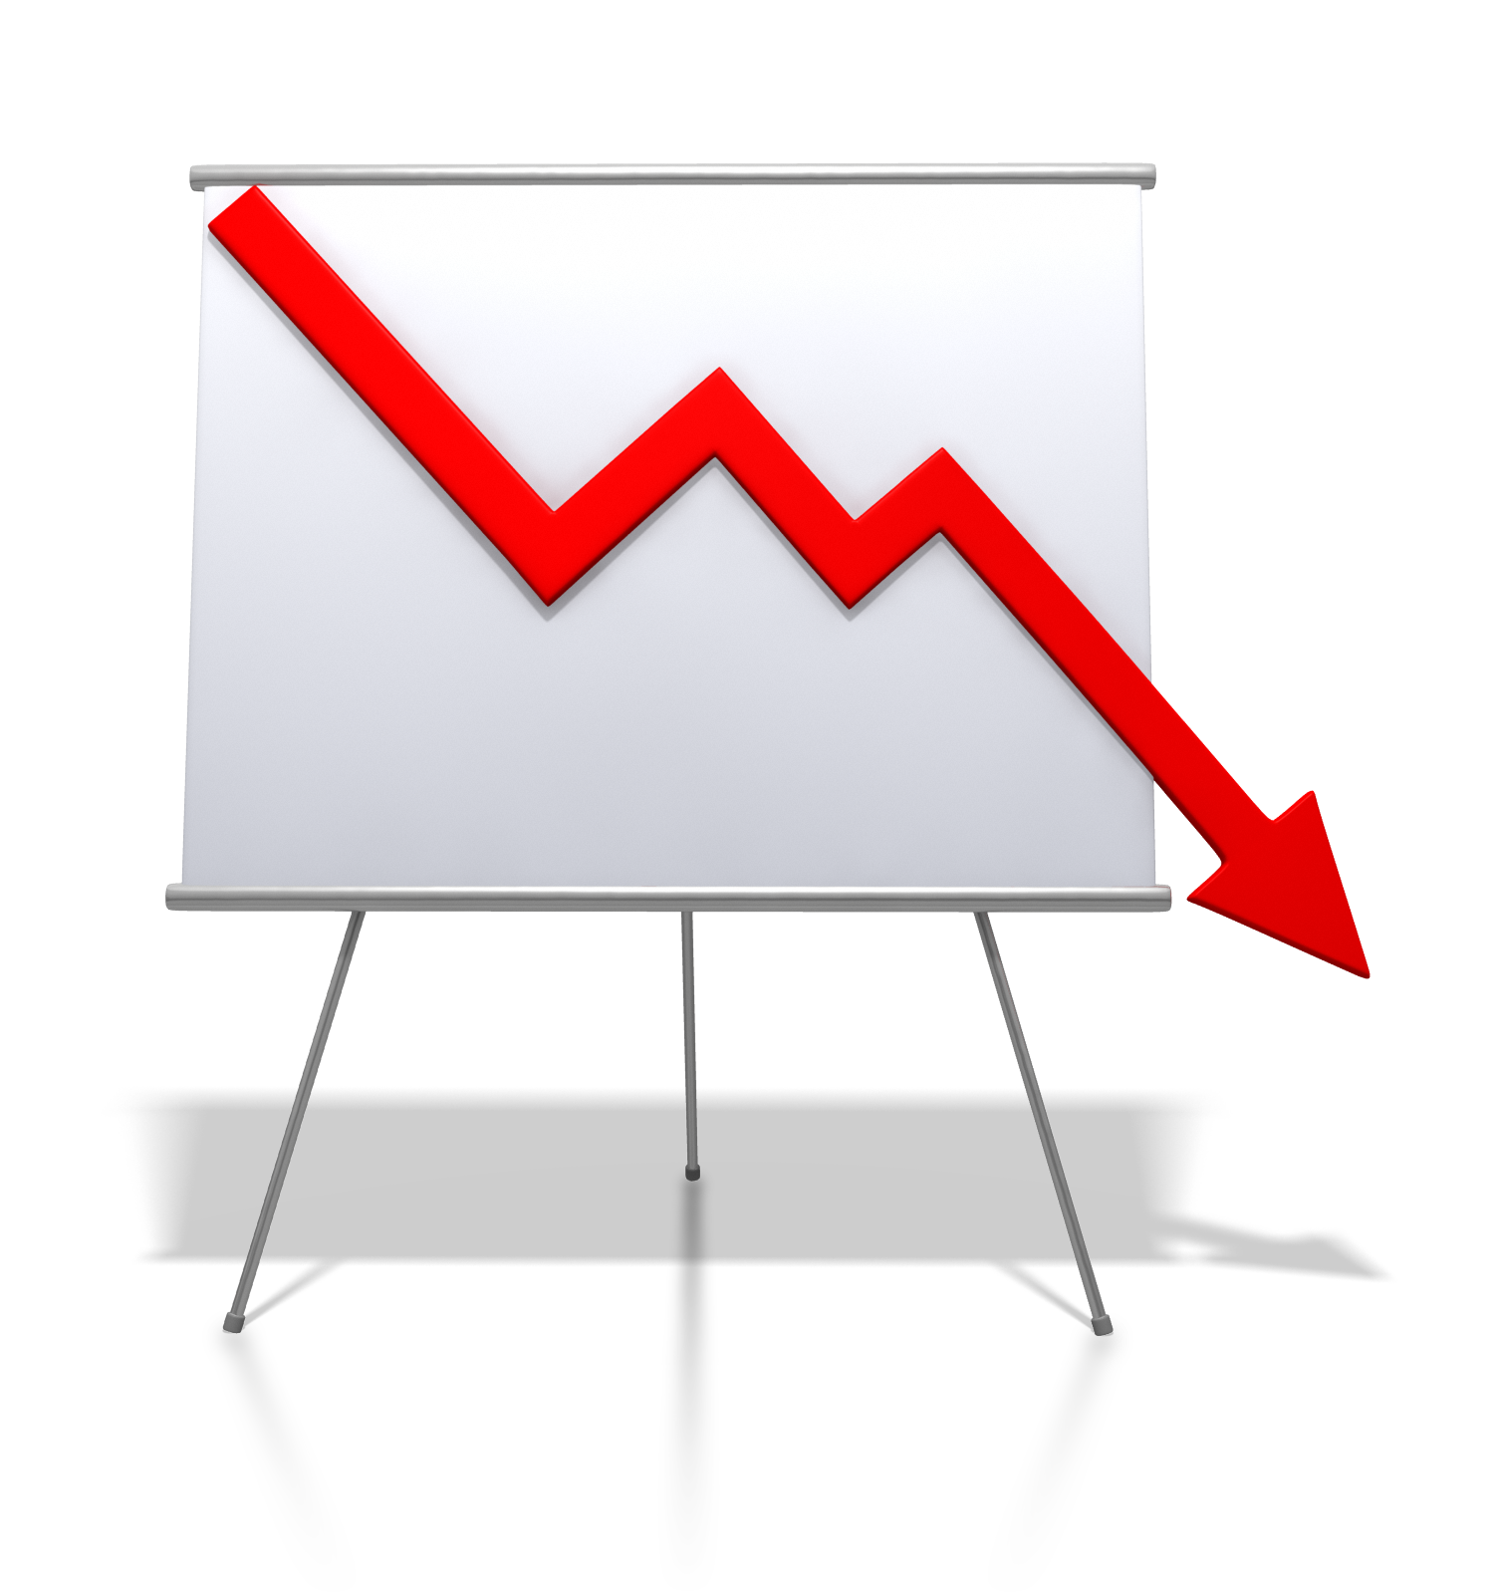
Reporting large deficits sitting in financial accounts

Slide 23
Engineers view of Highway
Engineer’s view
Pavement Surface – rehab after 10 years
Pavement sub-base – replaced ~ 50 yrs
Earthworks – indefinite life for alignment

Slide 24
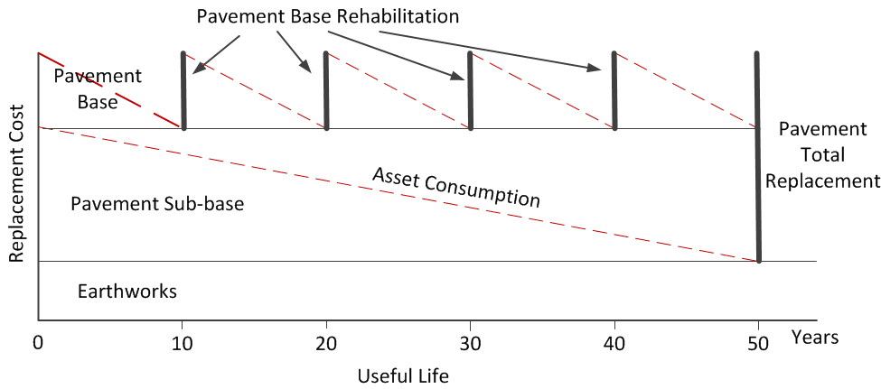
Accountant’s view of a Highway
Accountant’s view - 3 components
Surface
Sub-base
Earthworks
Annual average asset consumption = Replacement cost / Useful life

Slide 25
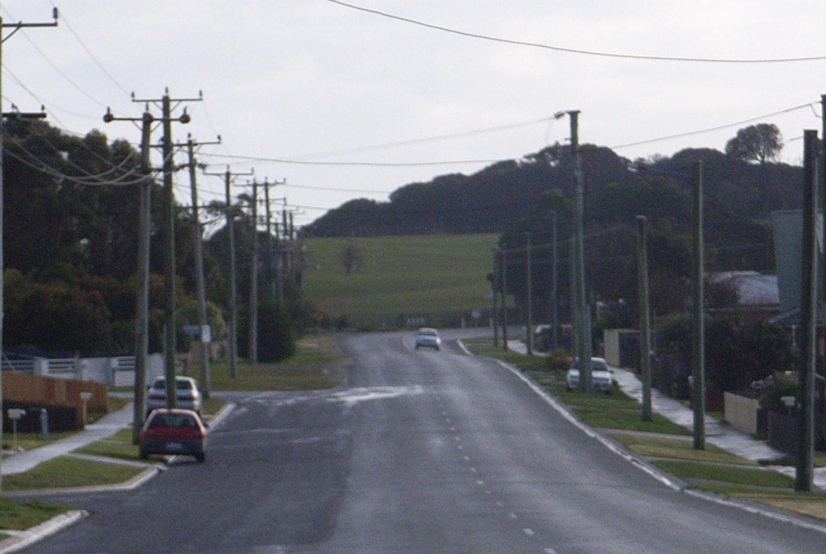
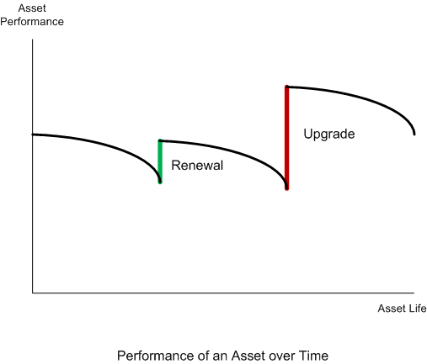

Slide 26
Assets recognised at component level

Slide 27
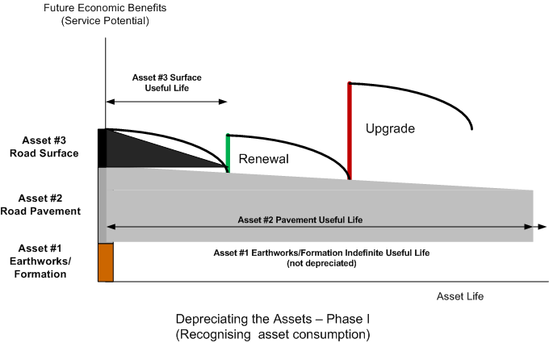
Assets recognised at component level
Consumption Phase 1

Slide 28
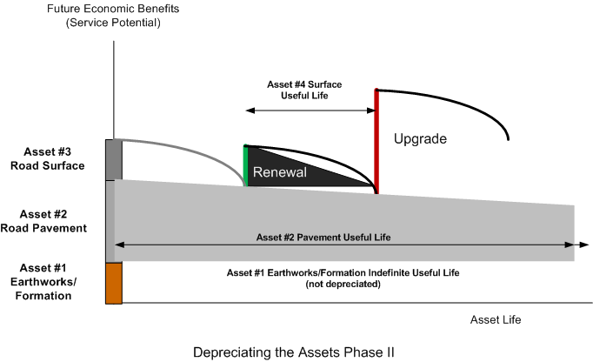
Assets recognised at component level
Consumption Phase 2

Slide 29
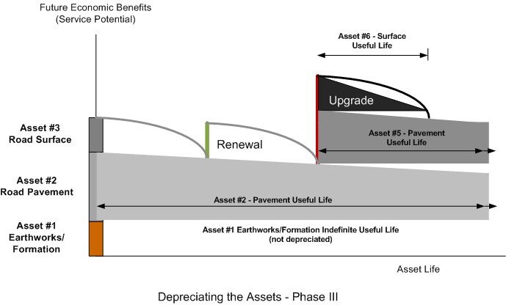
Assets recognised at component level
Consumption Phase 3

Slide 30
Assets recognised at component level
Segmentation

Slide 31
Infrastructure Accounting Data
Basic asset register data
Assets recorded in segments and components (where applicable)
Asset ID | Road No | Segment No | Road Name | Segment location (km) | Compon’t | Description | Date Const | Length (m) | Width (m) | Area (m2) | Condition | Useful Life (yrs) | Unit Cost ($/m2)
289.1.1 | 289 | 1 |  | 0-1.00 | 1 | Asphalt Surface | 1990 | 1000 | 6.1 | 6100 | Fair | 30 | 6.00
289.1.2 | 289 | 1 |  | 0-1.00 | 2 | Pavement | 1990 | 1000 | 9.1 | 9100 | Fair | 60 | 36.00
289.2.1 | 289 | 2 |  | 1.00-7.46 | 1 | Earth Surface |  | 6460 | 6.1 | 39406 | Poor |  | 0
289.3.1 | 289 | 3 |  | 7.46-7.60 | 1 | Concrete Pavement | 1995 | 140 | 6.1 | 854 | Fair | 50 | 50.00
Data required for valuation
Asset ID unique to the entity
Date acquired/ constructed

Slide 32
Infrastructure Accounting Data
Use for valuations (where applicable)
Assets valued as segments and components (where applicable)
Use data for asset renewal planning
Renewal year = Construction year + useful life
Renewal cost = Gross replacement cost
Asset ID | Component |  | Description | Date Const | Length (m) | Width (m) | Area (m2) | Condition | Useful Life (yrs) | Unit Cost ($/m2) | Repl Cost ($) | DRC ($) | Deprn ($)
289.1.1 | 1 |  | Asphalt Surface | 1990 | 1000 | 6.1 | 6100 | Fair | 30 | 6.00 | 36,600 | 6,100 | 1,220
289.1.2 | 2 |  | Pavement | 1990 | 1000 | 9.1 | 9100 | Fair | 60 | 36.00 | 327,600 | 119,100 | 5,460
289.2.1 | 1 |  | Earth Surface |  | 6460 | 6.1 | 39406 | Poor |  | 0 | 0 | 0 | 0
289.3.1 | 1 |  | Concrete Pavement | 1995 | 140 | 6.1 | 854 | Fair | 50 | 50.00 | 427,000 | 25,620 | 854
 |  |  |  |  |  |  |  |  |  |  | 406,900 | 222,820 | 7,534
Data can be used for AM planning

Slide 33
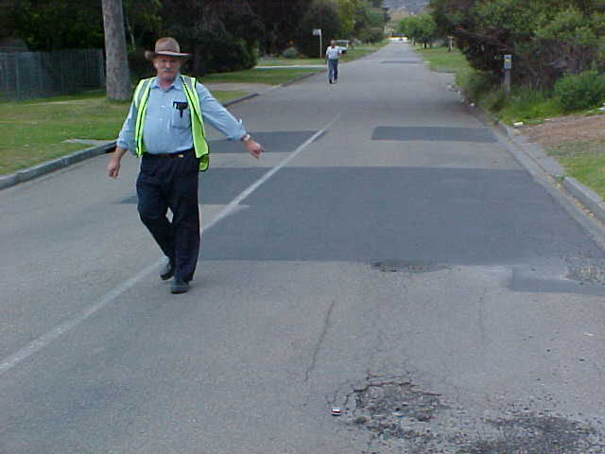
Useful life is not a look up table
Period that the asset provides the required level of service
  Use best information available
  Experience with similar assets
  When will replacement / disposal appear in the Works Program?

Slide 34
Useful life is not a look up table
Period that the asset provides the required level of service
  Use best information available
  Experience with similar assets
  When will replacement / disposal appear in the Works Program?
  Condition / Functional
  Capacity and Utilisation
  Cost and efficiency
  Safety and compliance
  Location, Obsolescence
  Availability of funding, etc

Slide 35
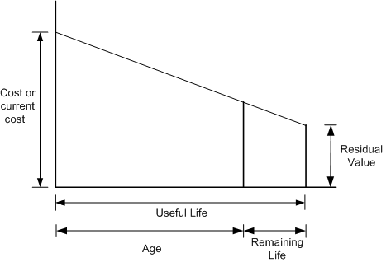
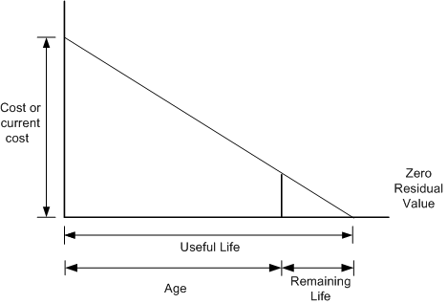
Use the data for asset renewal planning
What do you need to spend?
$$$
When you need to spend it?
Now
What do you need to spend?
$$
When you need to spend it?

Slide 36
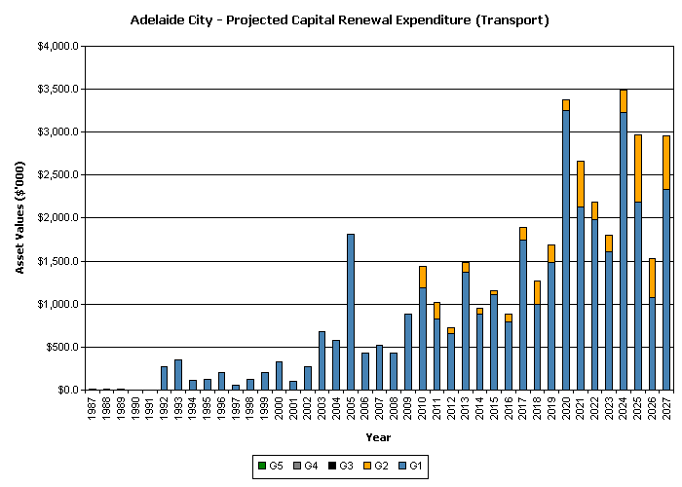
Project capital renewal requirements

Slide 37
Sustainability Involves
Trade-Offs
What do we need?
What can do without?
What can we defer?
Can we raise revenue?
Use borrowings?
What are our priorities?
  risks & consequences?

Slide 38
Know the long term impact of your decisions
Making the trade offs between service levels & funding

Slide 39




Financial Sustainability: maintaining infrastructure & financial capital over long term
ASSET MANAGEMENT PLAN
Services required,
how provided &
funds required
SERVICE & FINANCIAL SUSTAINABILITY
LONG TERM FINANCIAL PLAN
How services are to be funded

Slide 40
Sustainability is maintaining financial capital & infrastructure capital for long term
+

Slide 41
Move from annual budgeting to long term financial planning
Link long term expenditure to revenue
Make responsible use of debt

Slide 42
Illustrative Income Statement
 | $’000
Operating Income
Rates | X
Other Income | X
Total Operating Income | X
Operating Expenses
Other | X
Depreciation | X
Total Operating Expenses | X
Operating Result (aim: positive on average) | X
Other items (e.g. cap revenues) to get net surplus | X
Other items to get total comprehensive income | X
Ref: AIFMM, Table 2.6.1, p 2|8

Slide 43
Illustrative Balance Sheet
 | $’000
Assets
Cash, Inventories & Receivables | X
Infrastructure, Property, Plant & Equipment | X
Total Assets | X_{t}
Liabilities
Payables | Y
Borrowings | Y
Provisions | Y
Total Liabilities | Y_{t}
Equity | X_{t} - Y_{t}
Ref: AIFMM, Table 2.6.1.1, p 2|9.

Slide 44
Illustrative Income Statement
 | $’000
Operating Income
Rates | X
Other Income | X
Total Operating Income | X
Operating Expenses
Other | X
Depreciation | X
Total Operating Expenses | X
Operating Result (aim: positive on average) | X
Other items (e.g. cap revenues) to get net surplus | X
Other items to get total comprehensive income | X
Ref: AIFMM, Table 2.6.1, p 2|8

Slide 45
Depreciation is the allocation of cost of assets over its useful life
Calculate accumulated depreciation, fair value & annual depreciation expense

Slide 46
Are Financials Important?
Financial information provides information on
Value of infrastructure
Whether the infrastructure value is being maintained?
How much is consumed each year?
What the budget should be on average to maintain the infrastructure value
  e.g. depreciation approximates replacement needs

Slide 47
Embrace Accrual Accounting
Move from Cash Accounting
To Accrual Accounting
Incorporate Value & Consumption of Assets into Accounts (= Depreciation)
Use Revaluation Model, not Historic Cost
Project future funding needs (NAMS.PLUS)
Long Term Financial Planning
Financial Sustainability Indicators

Slide 48
AIFMM Financial Sustainability Indicators
Operating surplus ratio
Net financial liabilities ratio
Asset sustainability ratio
Asset renewal funding ratio

Slide 49
Financial Indicators
1. Operating Surplus Ratio | The operating result expressed as a percentage of total operating income
2. Net Financial Liabilities Ratio | The significance of net amount owed by an entity compared to its operating income for the period.
3. Asset Sustainability Ratio | The ratio of asset replacement expenditure relative to depreciation for a period. It measures whether assets are being replaced at the rate they are wearing out
4. Asset Renewal Funding Ratio | The ratio of the net present value of asset renewal and replacement funding accommodated over a 10 year period in a LTFP relative to the net present value of projected asset capital renewal and replacement expenditure identified in an AM Plan for the same period.

Slide 50
Financial Indicators
1. Operating Surplus Ratio
Are all operating costs covered?
2. Net Financial Liabilities Ratio
Are borrowings needed to accommodate peaks in capital expenditure outlays?
3. Asset Renewal Funding Ratio
Are we replacing assets as they are consumed?

Slide 51
Working together to successfully integrate infrastructure asset management
& long term financial planning

Slide 52
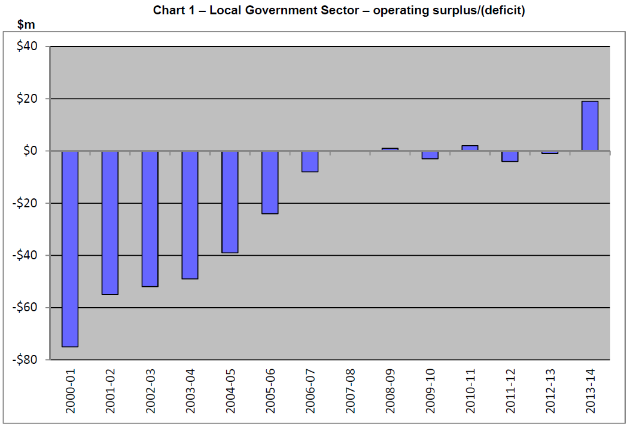
SA LG Financial Indicators Report 2015
SA Office of Local Government, 2015, p .1

Slide 53

IPWEA provides national frameworks, tools & resources www.ipwea.org

Slide 54


Slide 55

AM & LTFP puts you in the drivers seat www.ipwea.org/AM

Slide 56

AM & LTFP puts you in the drivers seat www.ipwea.org/AM

Slide 57
Asset Management in context of broader financial reporting
Chris Champion
Director International
IPWEA
chris.champion@ipwea.org

